Slide 1



Enterprise Academy
Solution Architect / GTM
User Guide

Slide 2
Introduction
Welcome! This guide has been designed for the Axiata FastForward Enterprise Academy (EA) to help participants in navigating the FUSE, EY Spotmentor and EY CompetencyConnect platforms throughout their learning journey.
Overview of platforms
The guide details clear instructions on how to navigate through different steps of the CDI process.
STEP 1 STEP 2 STEP 3
FUSE
FUSE is Axiata FastForward’s virtual learning platform – an exciting communication, learning and collaboration platform that lets you create, share and access knowledge.
Participants can access EY Spotmentor through the Enterprise Academy (EA) Community Page on FUSE.
EY Spotmentor
EY Spotmentor is an AI driven intuitive skill, learning and career platform. It enables the curation of relevant content to develop learning journeys based on individual needs.
Participants can view their skills gaps and access their hyper-personalised learning journey on EY Spotmentor.
EY CompetencyConnect
EY CompetencyConnect is a virtual competency inventory and learner experience platform. With a repository of over 250+ ready to use competency development tools, EY CompetencyConnect helps organizations base-line technical, functional and behavioural competencies of employees and increases the accuracy and relevance of development planning with confidence and ease.
Participants can complete their Capability Development Inventory (CDI) – (1) Case study and session with virtual facilitator, (2) Self ratings and (3) Manager ratings on EY CompetencyConnect.
FUSE
EY SPOTMENTOR
EY COMPETENCY CONNECT

Slide 3
User Guide Overview
Key information on CDI and IT checklist
Step-by-Step Guide
through the platforms (Participant)
Step-by-Step Guide
through the platforms (Manager)
Frequently Asked Questions (FAQs)
Key Contact Persons

Slide 4
User Guide Overview
Key information on CDI and IT checklist
Step-by-Step Guide
through the platforms (Participant)
Step-by-Step Guide
through the platforms (Manager)
Frequently Asked Questions (FAQs)
Key Contact Persons

Slide 5
Key information on CDI
All participants are required to sit for a Capability Development Inventory (CDI) which will consist of the following two (2) phases:
1. BUSINESS CASE STUDY (~2.5 HOURS)
The CDI business case study will be made available during the following period:
22 – 24 Sep
You are required to complete the business case study on FUSE > EY Spotmentor any time within the above mentioned period (in one sitting)
Please refer to Steps 1 – 11 of this User Guide (Step-by-Step Guide through the platforms – participant) on how to access and complete the business case study.
Proctoring is enabled for the entire CDI process. Please enable your webcam when asked - this is mandatory
You are required to provide an answer for each question. There are no right or wrong answers to the questions. Your approach will be evaluated in the given situation
2. SESSION WITH LIVE-VIRTUAL FACILITATOR (~30min)
You are required to have a 1:1 interactive session with a live-virtual facilitator (centered around the same case study) during a scheduled timeslot.
You will receive an email invitation from axiatafastforward.cdi@axiatafastforward.com. No re-scheduling is allowed
Login to FUSE > EY Spotmentor on time. Please be punctual as we have mapped your schedule with a facilitator to conduct your session
You are encouraged to read through the background information again beforehand in order to prepare for your session with the facilitator
Please refer to Steps 12 – 17 of this User Guide (Step-by-Step Guide through the platforms – participant) on how to access your session with the facilitator
Ensure you have a laptop with stable internet connection, fully functioning webcam and microphone
Please use Google Chrome browser and enable pop-ups
After you have completed your session with the facilitator, please complete your self-ratings. Please refer to Step 18 of this User Guide (Step-by-Step Guide through the platforms – participant) on how to perform your self rating
Overall flow of CDI activities:
Login
Background information reading
Task 1
Task 2
Task 3
Task 4
Self ratings
Request Manager ratings
CDI Feedback Form
Approx. 20-30 min
(not timed)
30 min
L3: 60 min
L4: 50min
60 min
30 min
10 min
5 min
Business Case Study
Session with live-virtual facilitator

Slide 6
IT Checklist for CDI
In order to ensure there are no technical difficulties on the day of your CDI, you need to ensure the below items are working fine:
 | Items
 | Laptop with stable internet connection Ensure laptop is readily available with a stable internet connection
 | Credentials for FUSE and EY Spotmentor platforms Login to FUSE and EY Spotmentor in advance to validate the accuracy of credentials Note: Please type your password (do not copy & paste) and ensure that there is no space (before and after) when entering your password
 | Enable pop-ups in your Chrome browser* Pop-ups need to be enabled on the system before hand (Go to Settings -> Site Settings -> Pop Up -> Unblock)
 | Fully functioning webcam and microphone In order to access the Go-to-Meeting video calls for discussion with facilitator, webcam and microphone should be fully functional; Functionality should be tested ahead in time
 | Go-to-Meeting* Test Go-to-meeting link by clicking here. Click ‘Join Now’ > Open GotoOpener > OK, I’M READY.
*Step-by-Step is available in the annexures of this User Guide. Please click on the corresponding hyperlinks

Slide 7
User Guide Overview
Key information on CDI and IT checklist
Step-by-Step Guide
through the platforms (Participant)
Step-by-Step Guide
through the platforms (Manager)
Frequently Asked Questions (FAQs)
Key Contact Persons

Slide 8
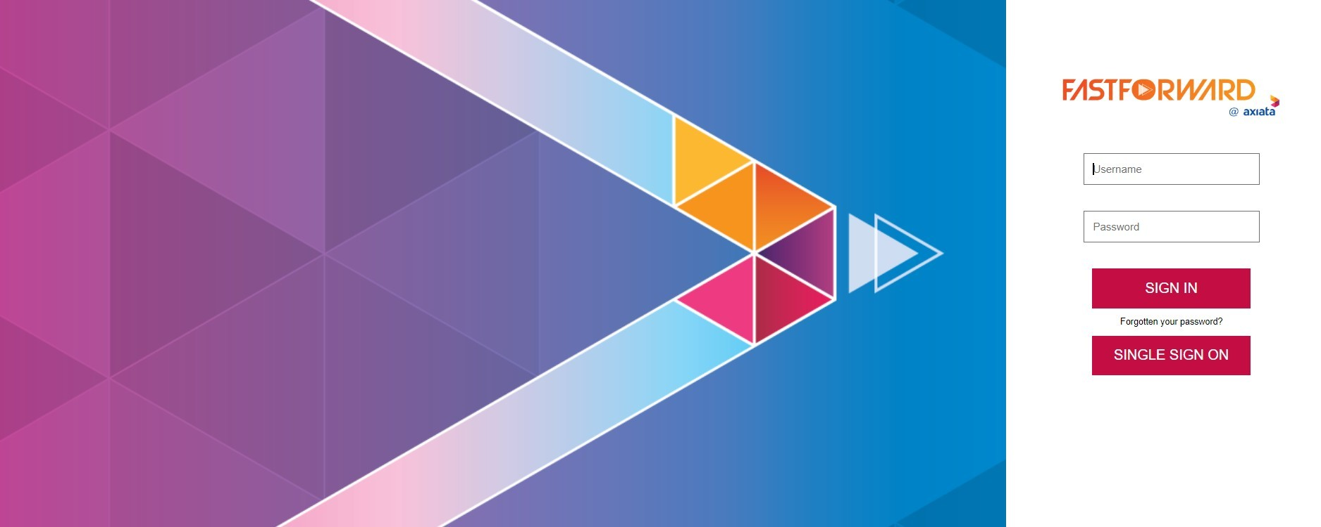
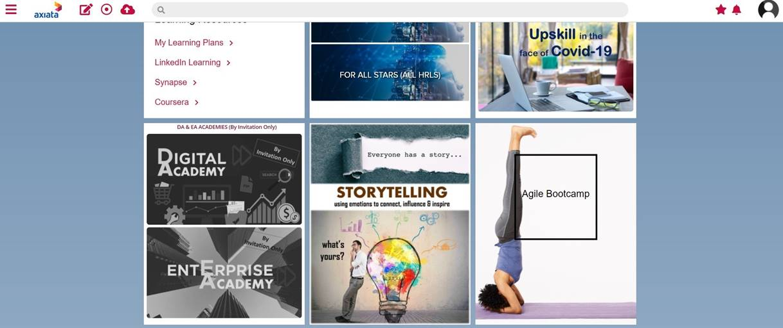

How do I access the FastForward module?
Go to axiata.fuseuniversal.com and enter the credentials provided to you by FUSE. Then, click SIGN IN
Note for Celcom, XL, Robi and NCell employees:
Please use your existing IDMS ID & Password for Single Sign On.
URL: https://axiata.fuseuniversal.com/users/sign_in
ID: <enter your corporate email address> e.g. ali@celcom.com.my
Password: (Leave this BLANK)
Click “SINGLE SIGN ON” and then enter your IDMS password to enter Fuse.
Click on the Enterprise Academy widget to enter into the EA Community Page
A
B
A
B

Slide 9

How do I access EY Spotmentor?
On the Enterprise Academy Community Page, search for the EY Spotmentor Corner widget, and click on Access Spotmentor
A
A

Slide 10
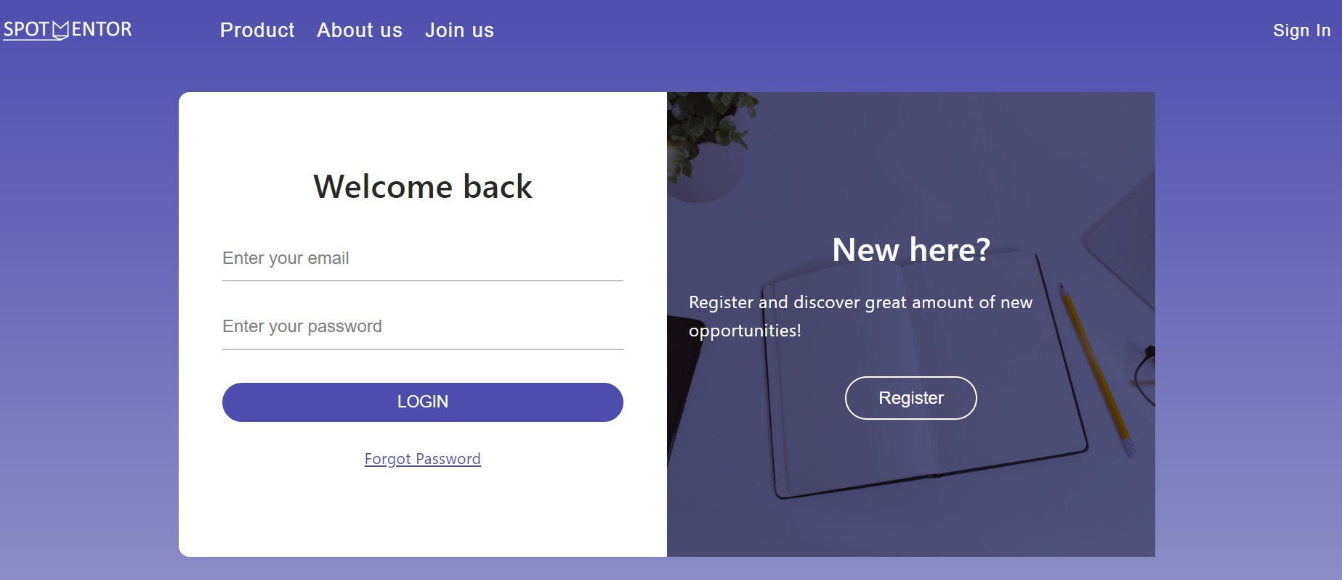
How do I login to EY Spotmentor?
For FIRST TIME login, insert your EY Spotmentor username and password provided by admin@spotmentor.com. Please type your password (do not copy & paste) and ensure that there is no spacing when entering your password
Note: For REPEAT USERS login, repeat Step 1 until Step 2. Then click on Goto Platform in the top right corner of the page and enter your credentials
A
A

Slide 11
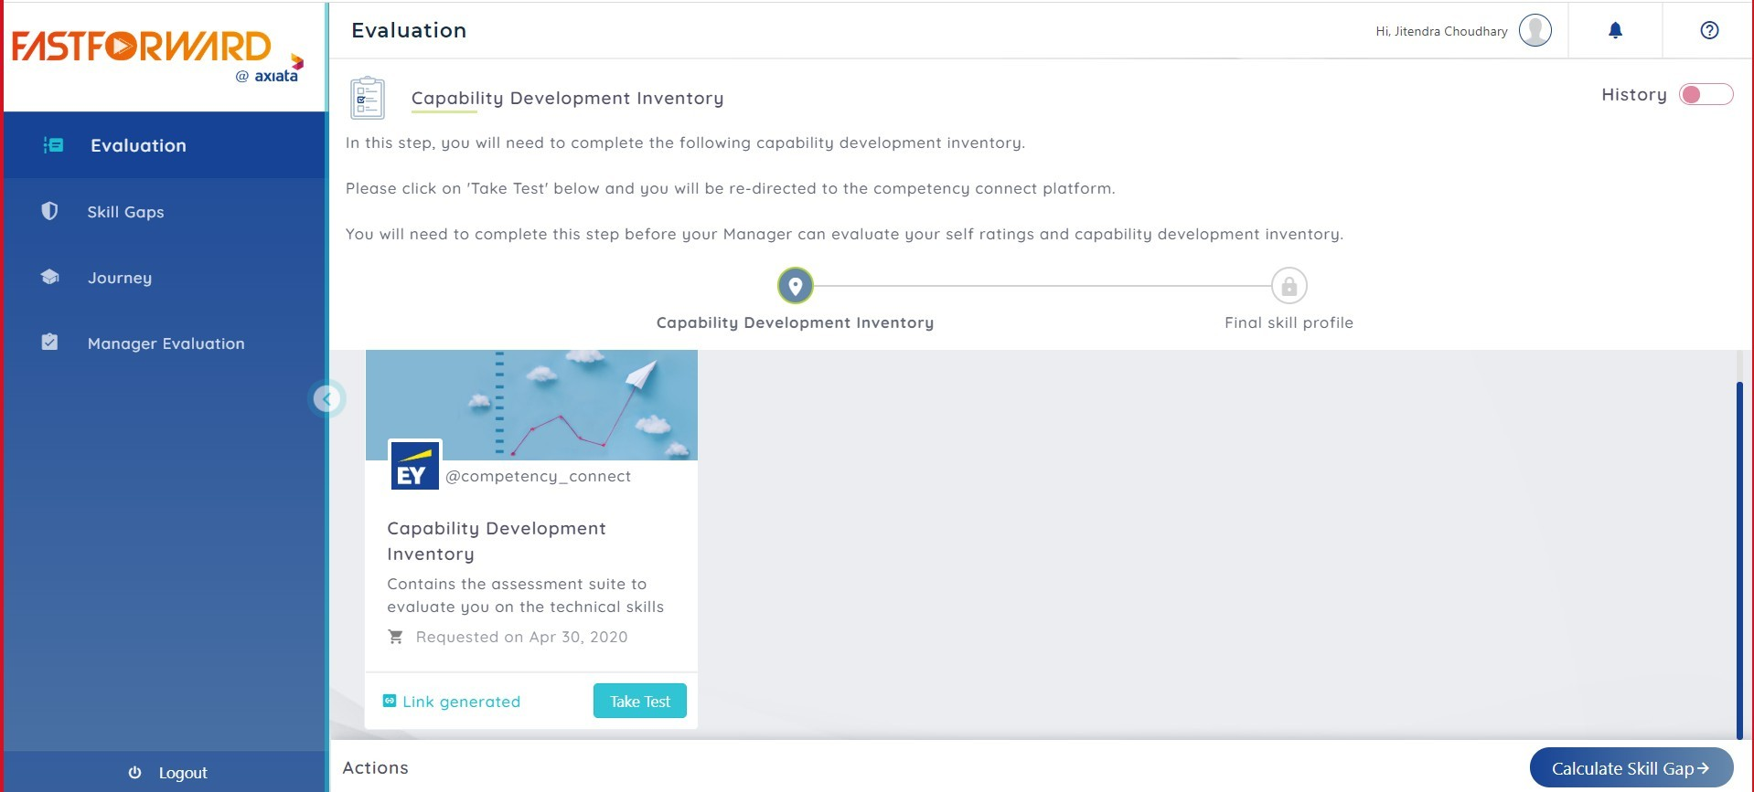
4. How can I initiate my CDI?
On the EY Spotmentor landing page, click Take Test to initiate your CDI (Capability Development Inventory)
A
A

Slide 12
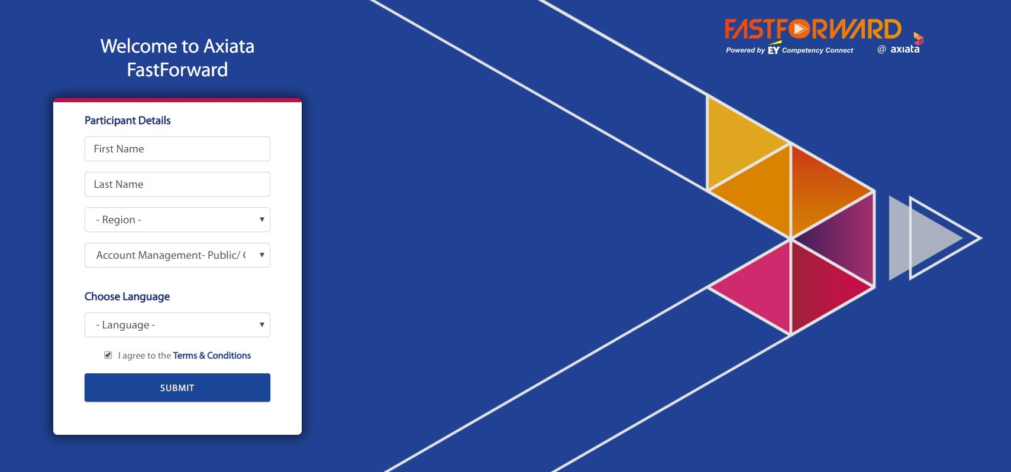
5. How to Login to CompetencyConnect?
Input First and Last Name in the box provided
Your relevant Region and Role Cluster from will be autopopulated
Choose a preferred Language to take the CDI
Note: Currently, only English, Bahasa Indonesia, Tamil and Sinhalese is available
Read the Terms & Conditions and tick the box
Ensure accuracy of details before clicking on Submit
Note: At any point during the CDI, participants can switch the language of the case by clicking on the Language tab in the top right corner of the page (applicable only to Direct Sales participants).
A
B
C
D
E
A
B
C
D
E

Slide 13
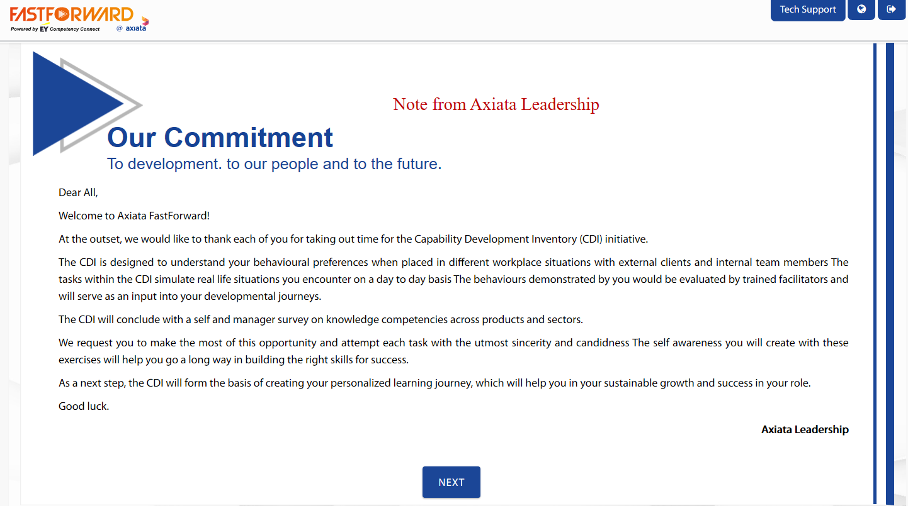
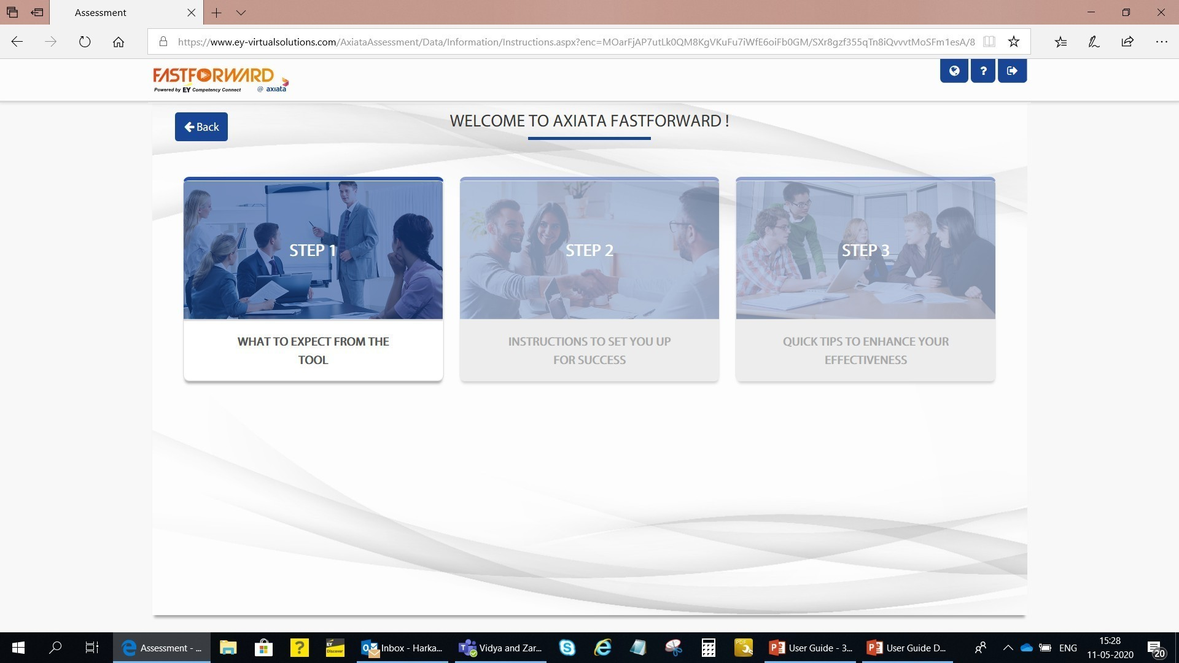
6. Where are the instructions for CDI? (1/2)
Please view the leadership note/video from your Enterprise Head and click Next
Click on the images to read the instructions step by step
A
B
A
B

Slide 14
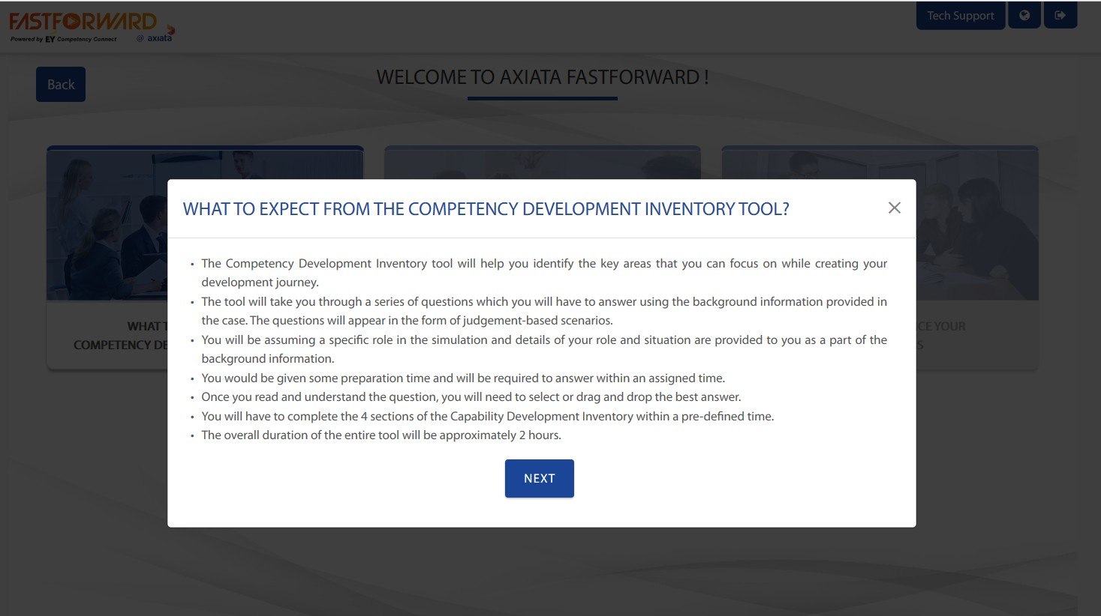
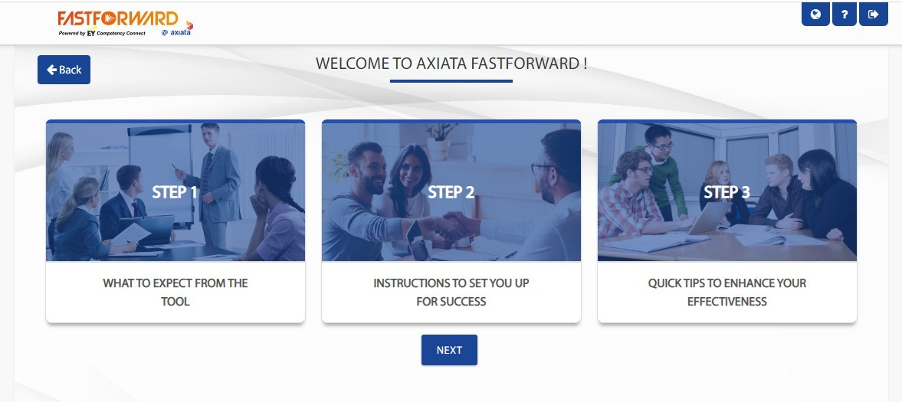
6. Where are the instructions for CDI? (2/2)
Once you have familiarized yourself with the instructions for each step, click on Next to move forward to the next section
Upon completion of all steps, click Next
C
D
C
D

Slide 15
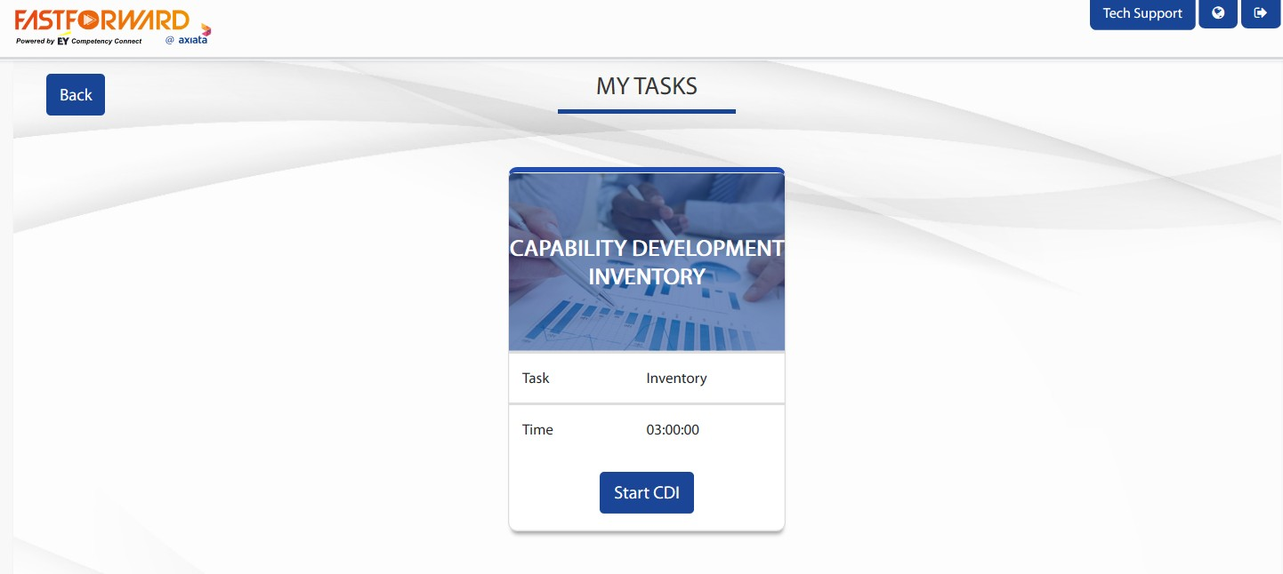
7. How to start the CDI?
Click Start CDI to proceed to the background information
A
A

Slide 16
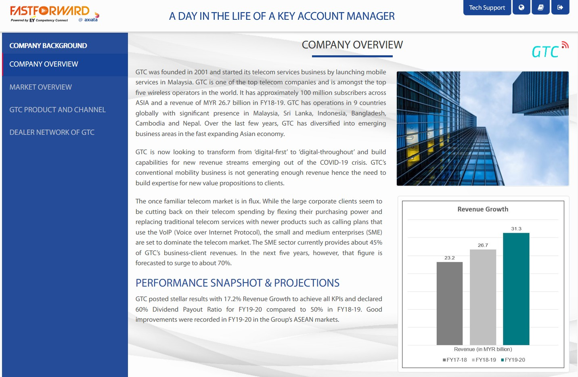
8. Background Information for the Simulation
As a part of the Simulation, you will now be able to access background information of a fictitious organization called GTC
Background information is available across several tabs/sections:
Company Background
Company Overview
Market Overview
GTC Product and Channel
Dealer Network of GTC
You need to go through the sections in a sequential manner one by one; Upon completing one section, the tab for the next section will be activated; You may, at any time during the CDI, go back to a section of the information here
A
A

Slide 17
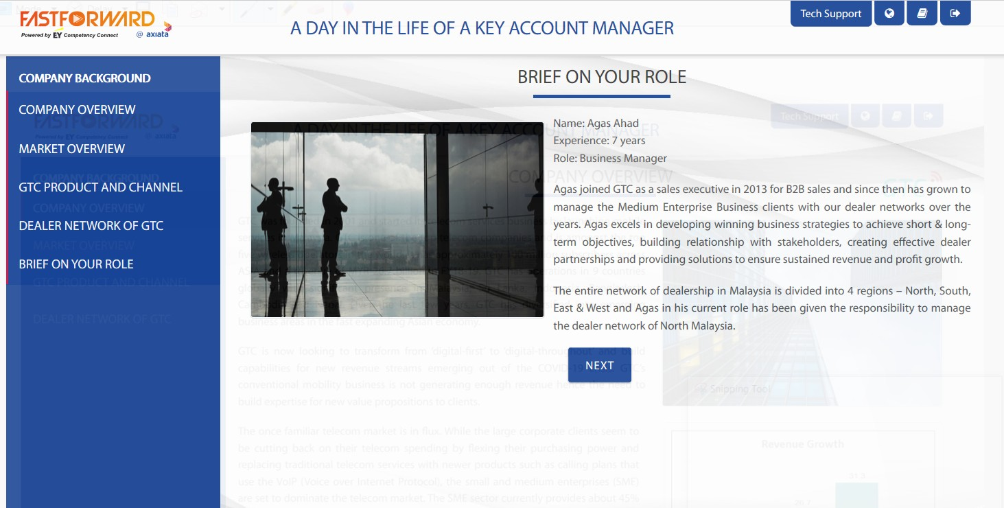
9. Where can I see my role in the Simulation?
Once you have finished reading the background information, you would be directed to the page with information about your role in the simulation. Click Next once you have familiarised yourself with your role
A
A

Slide 18
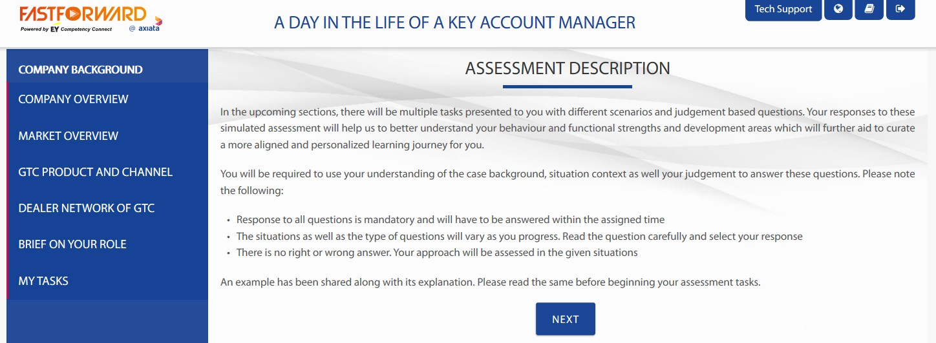
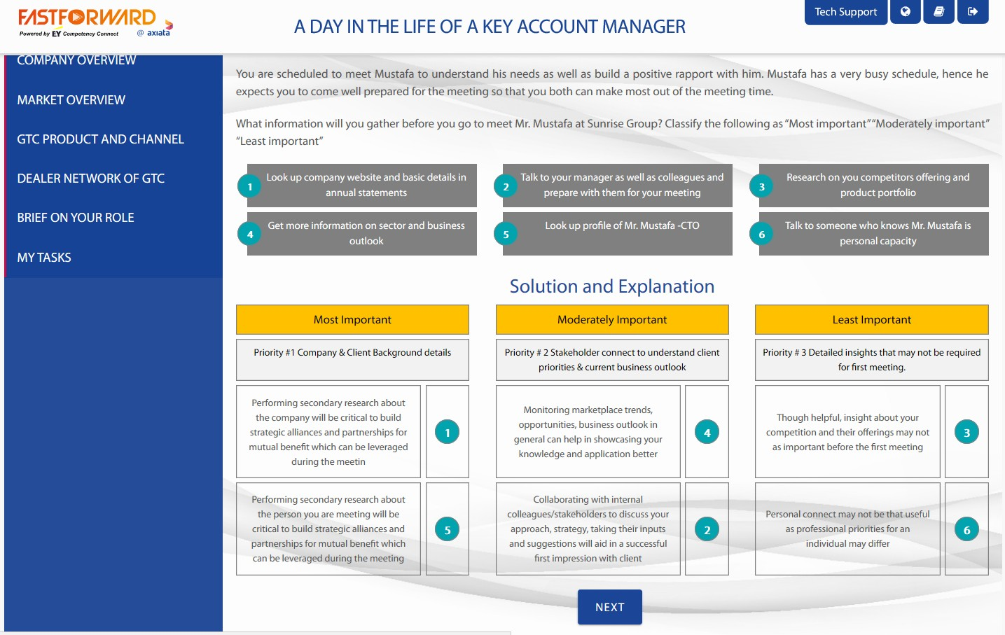
10. How to start completing my Tasks? (1/2)
You will be given a brief description on the upcoming case study assessment. Click Next when you have finished reading
A sample question will be shown for your better understanding on the types and structure of questions that you will face. Click Next to proceed to the tasks overview
A
B
A
B

Slide 19
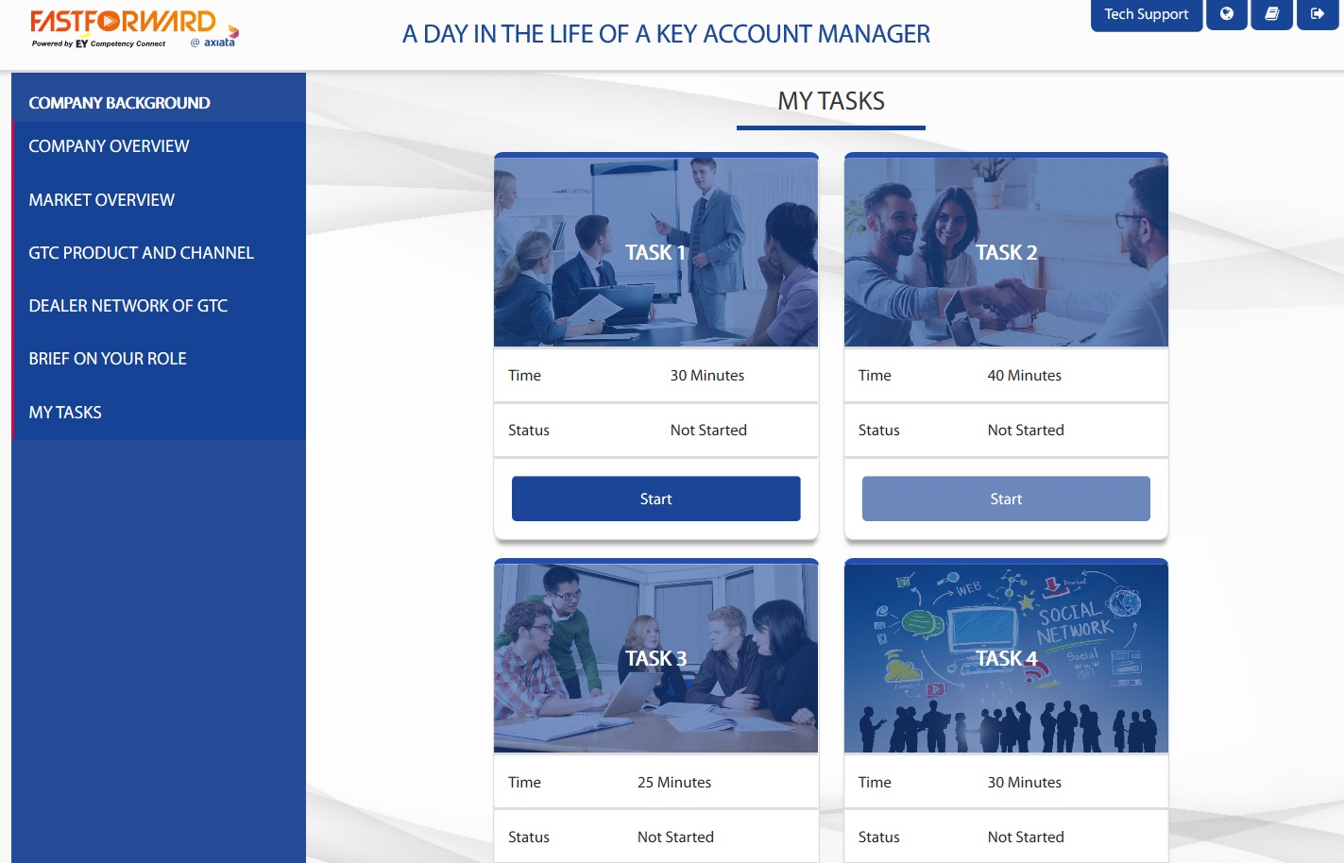
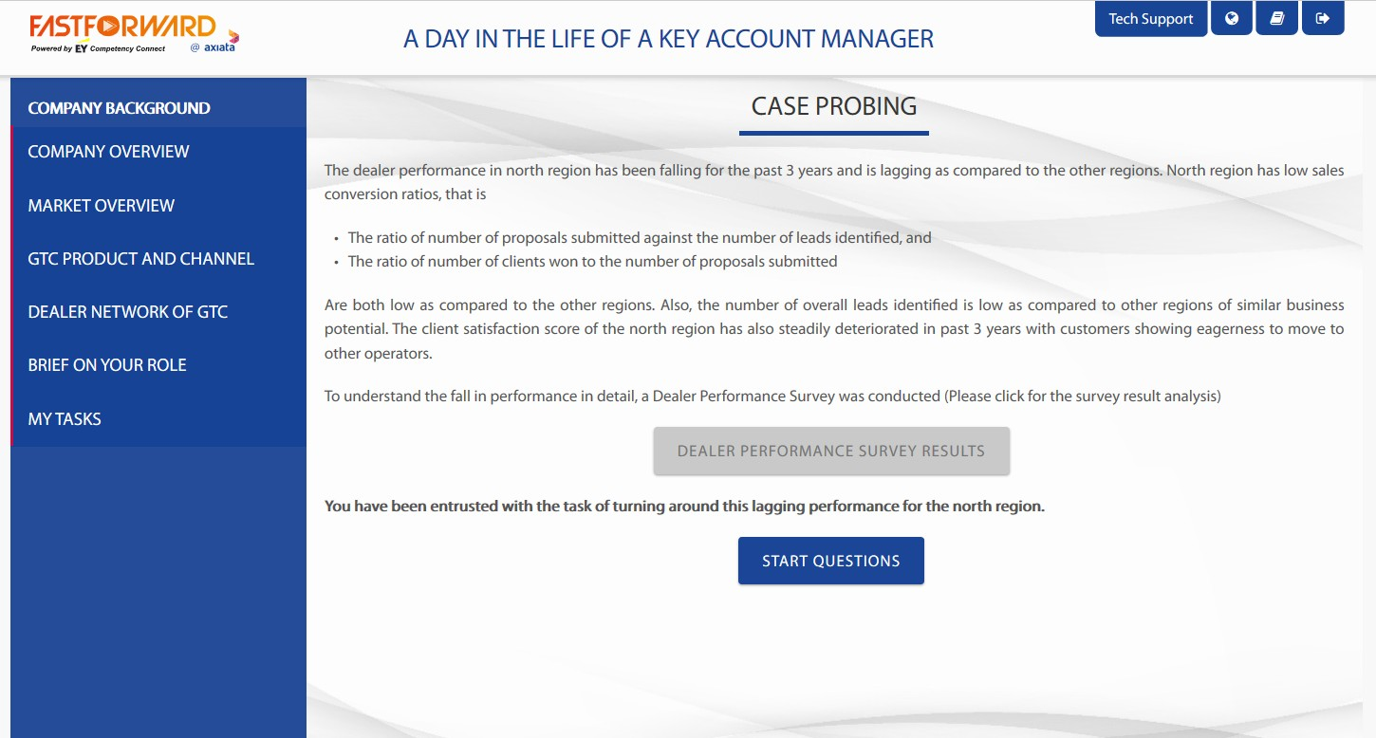
10. How to start completing my Tasks? (2/2)
You are required to complete Task 1 – 3 (in one sitting) any time within the stipulated period mentioned in page 5.
Click Start to begin a task. You are required to complete each task within the specified timeframe
Every task will contain additional information in relation to the case study. Please click on the grey box to view more information
Click Start Questions when ready
A
B
C
A
B
C

Slide 20
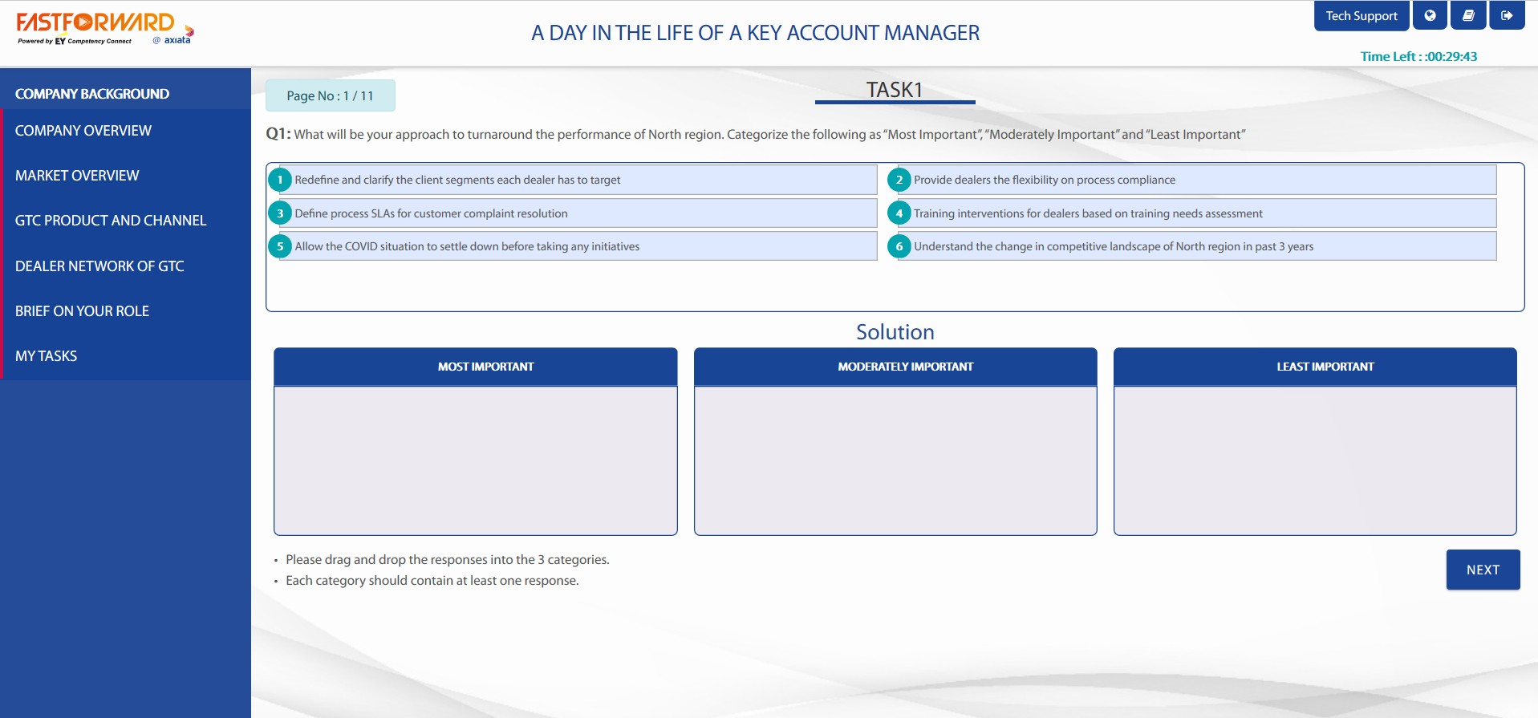
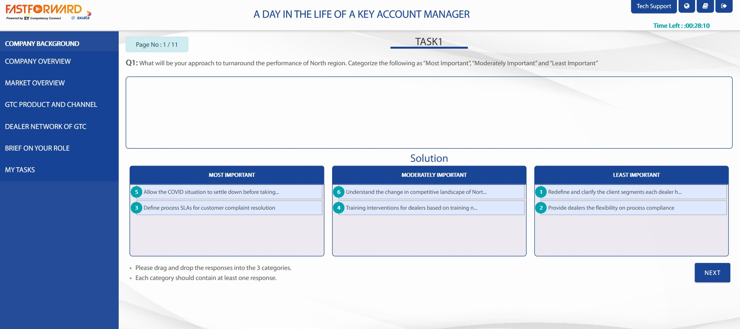
11. What does Task 1 – 3 entail? (1/2)
The timer will then appear in the top right corner of the page
For Task 1 and 2 – Each question will require you to drag and drop the responses into the appropriate categories
Each category should contain at least one response and all responses need to be categorized. Click Next once complete
A
B
C
A
B
Illustrative
C

Slide 21
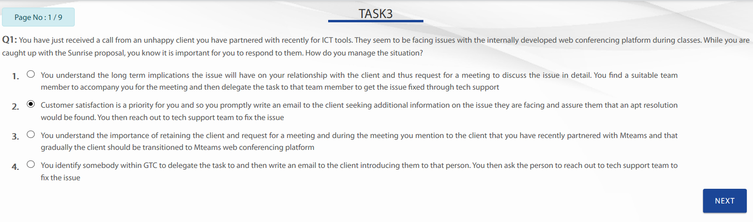
11. What does Task 1 – 3 entail? (2/2)
For Task 3 – Multiple choice questions – please select the best option and click Next
A
Illustrative
A

Slide 22
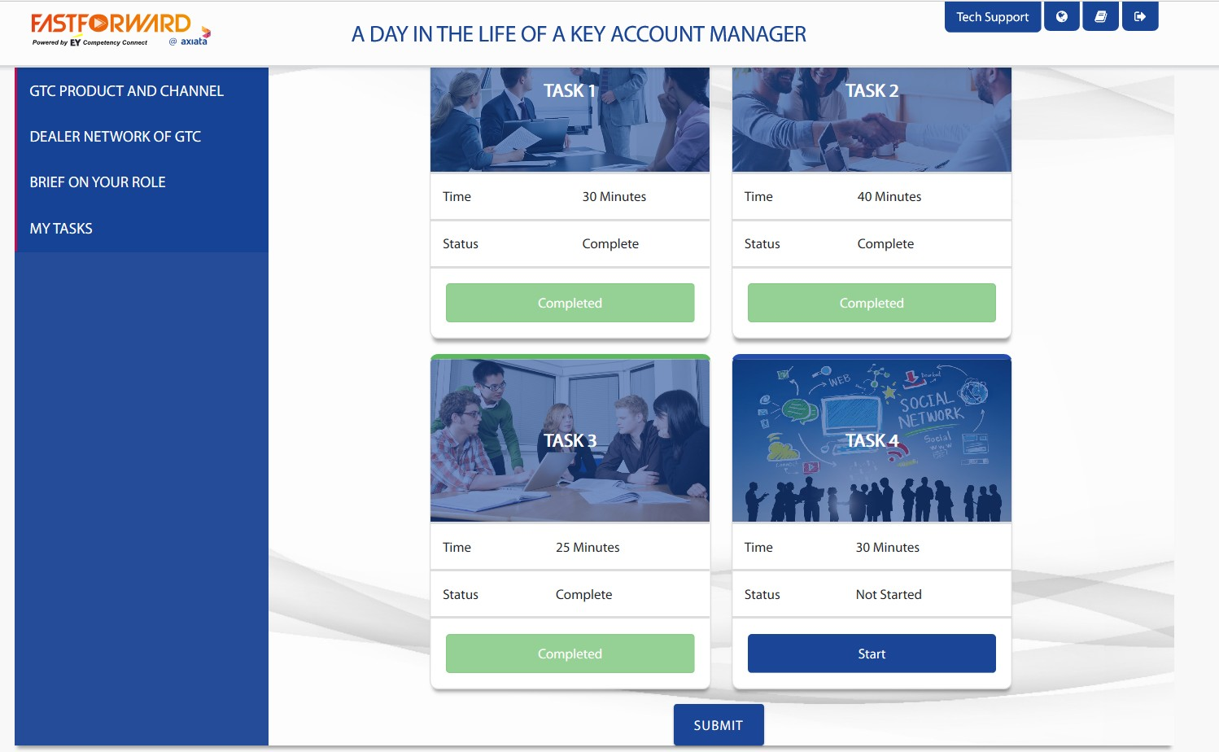
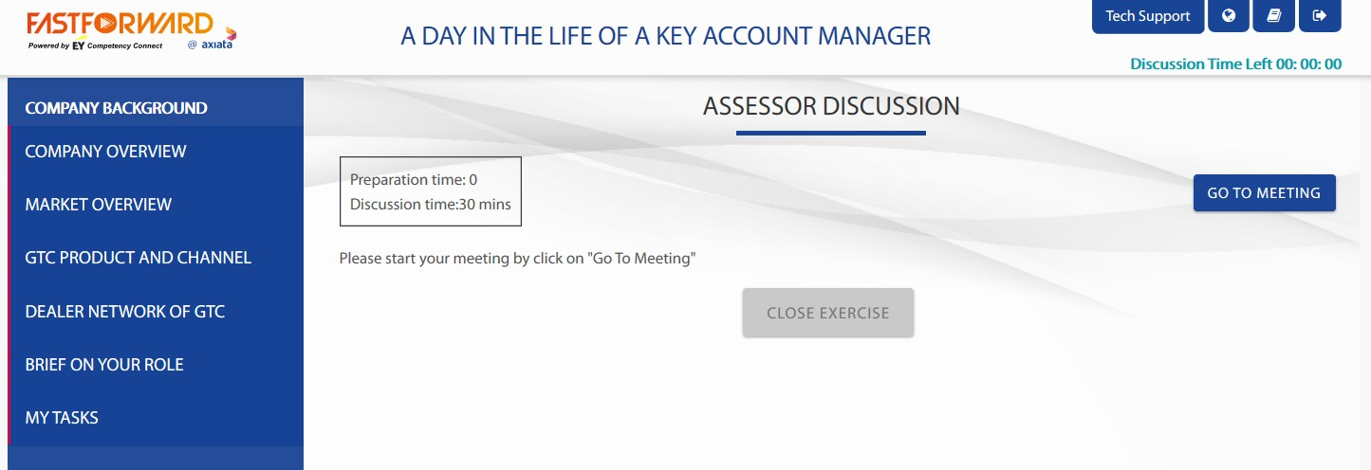
12. What does Task 4 entail? (Session with live-virtual Facilitator)
On the day of your scheduled session with live-virtual facilitator, click Start on Task 4
Click on Go To Meeting to initiate your discussion with the facilitator
A
B
A
B

Slide 23
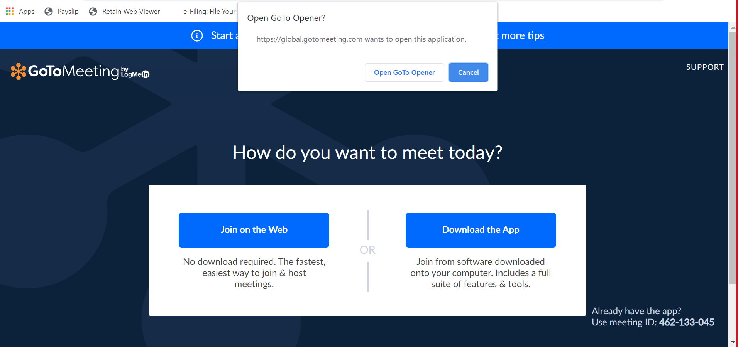
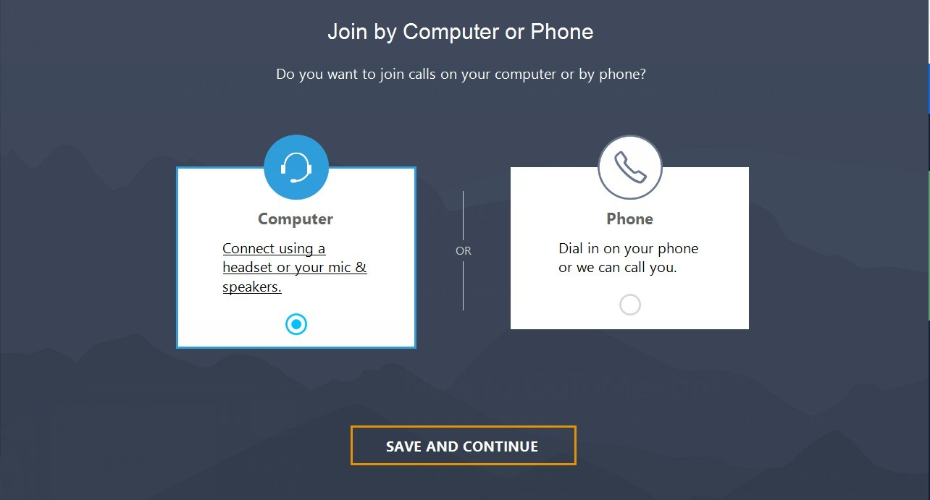
13. How to Access Go to Meeting? (1/3)
Click Open GoTo Opener in order to run the application. If nothing happens, then click on Join on the Web
Select join by Computer
A
B
A
A
B

Slide 24
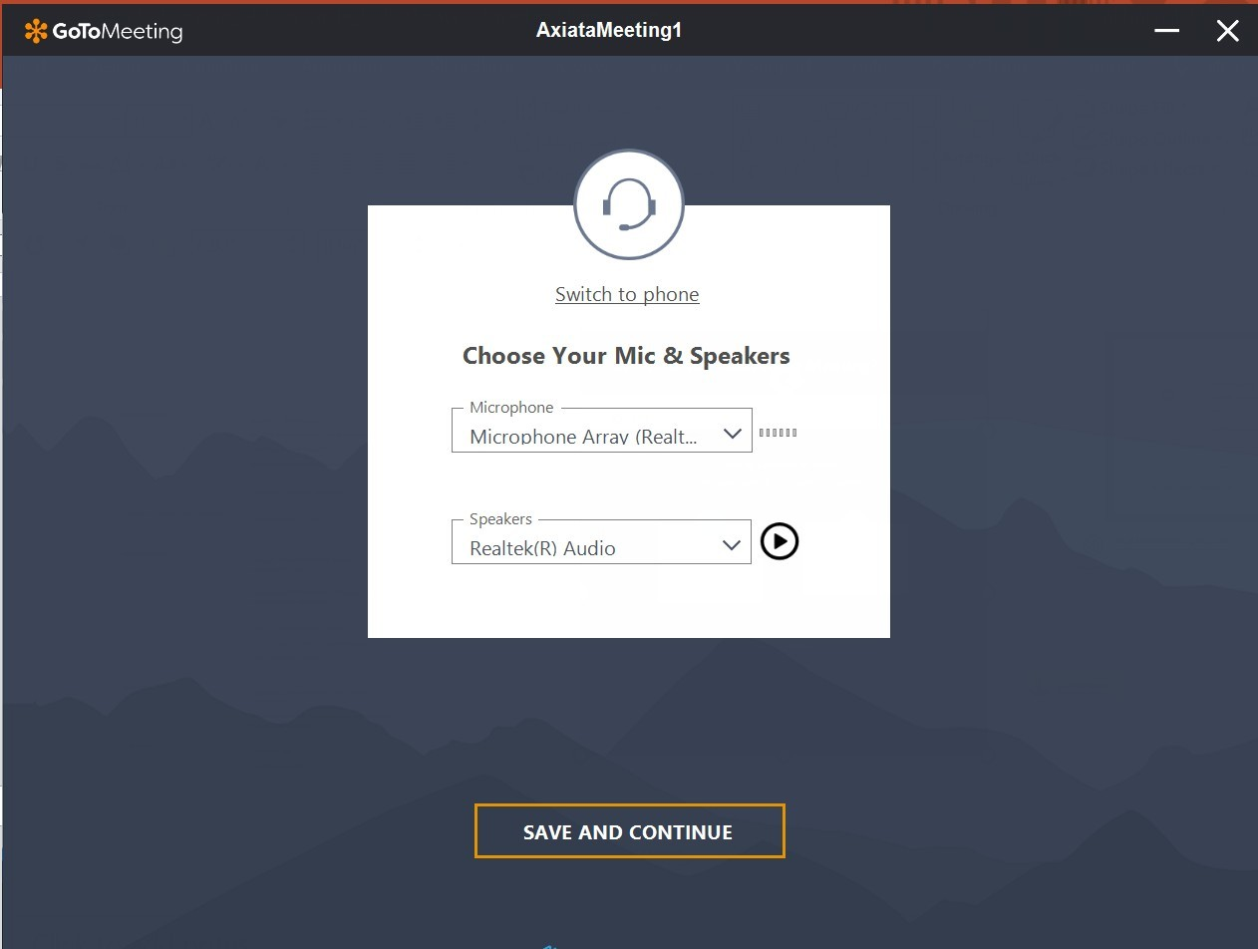
13. How to Access Go to Meeting? (2/3)
Choose your Microphone and Speaker
Click Save and Continue
C
D
C
D

Slide 25
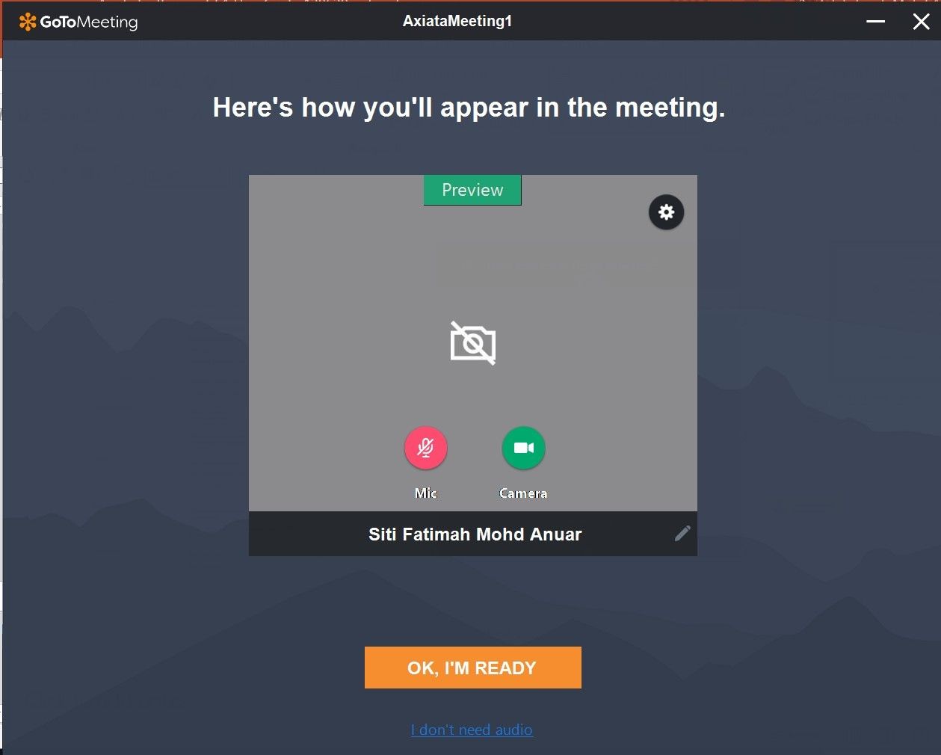
13. How to Access Go to Meeting? (3/3)
Ensure your camera is enabled and you are unmuted
Click OK, I’M READY
E
F
E
F

Slide 26
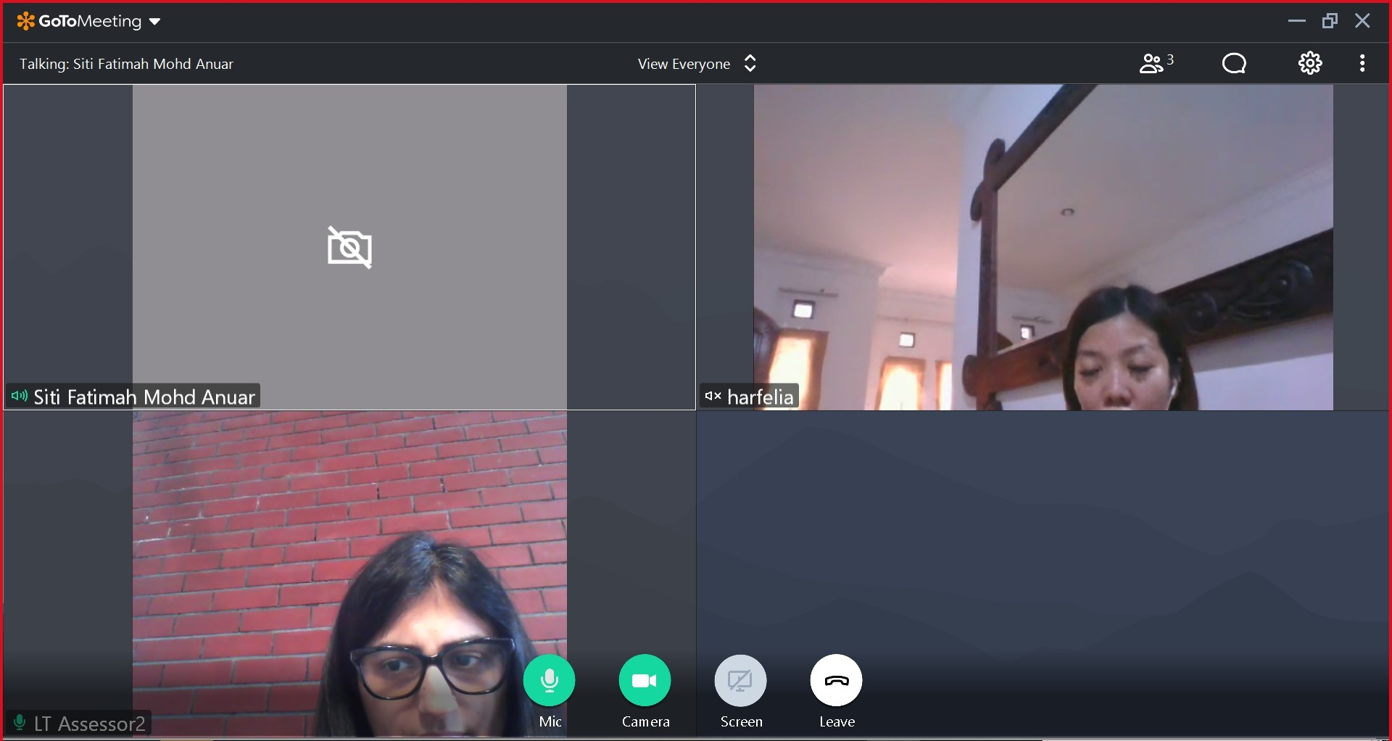

14. How to Leave the Go to Meeting?
Once you are done with the Go To Meeting, click Leave and close the Go To Meeting window and tab
A
A
A
Mic

Slide 27
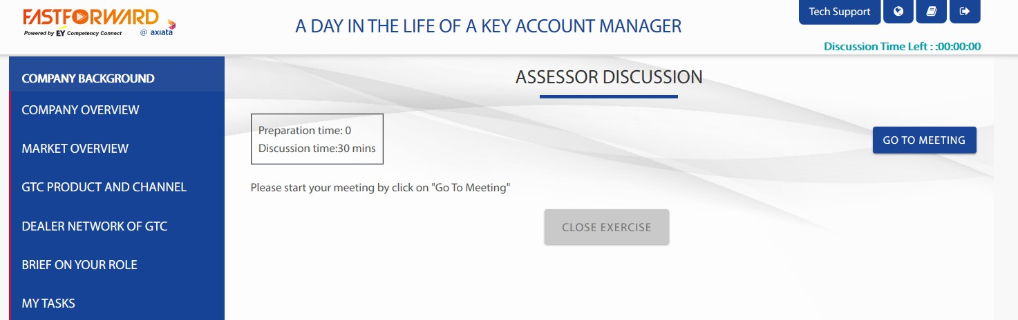
15. How to Complete Task?
Completion of task will be recorded once you click on Close Exercise tab after the discussion with the facilitator
A
A

Slide 28
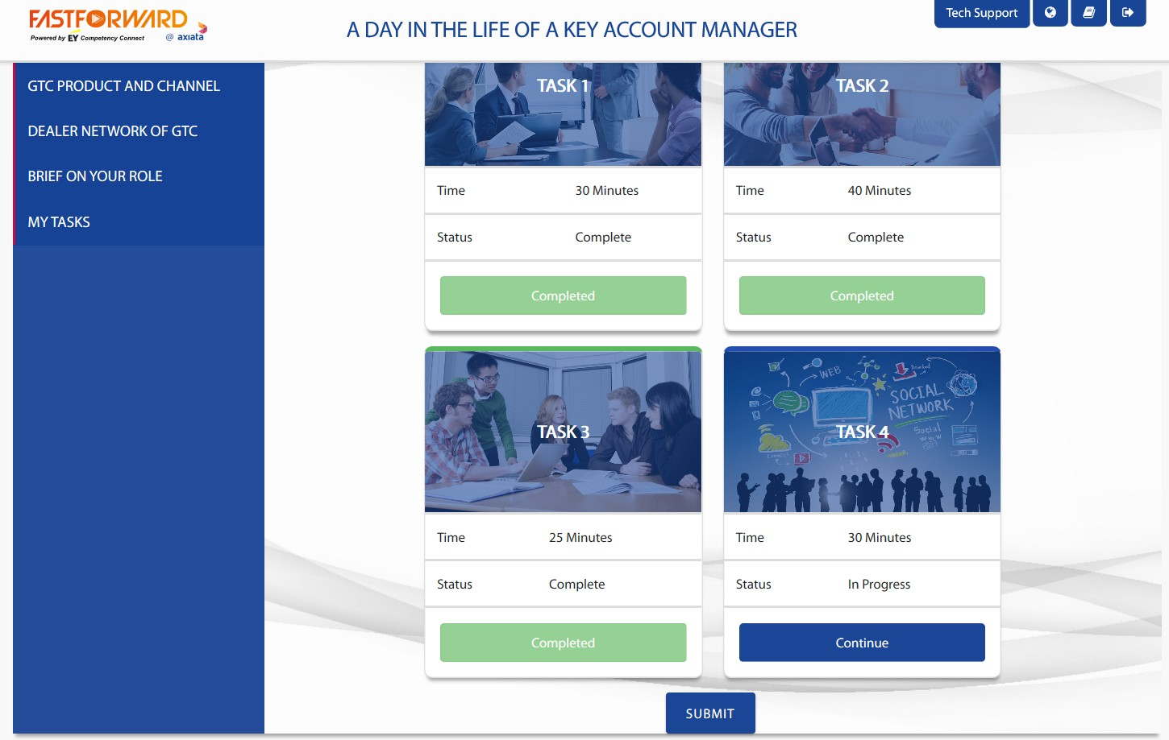

16. What to do after I have completed all my Tasks?
When all Tasks are completed, click on Submit to finish the CDI process
A
A

Slide 29
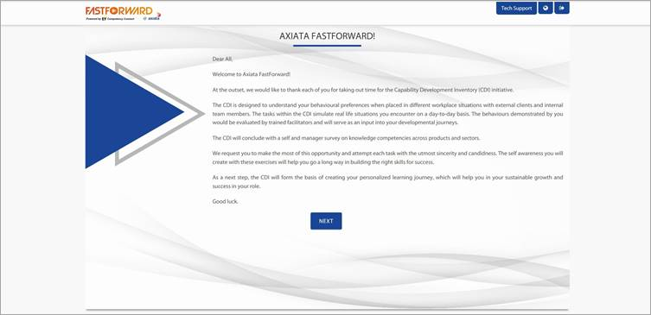
17. Additional Tabs
At any time during the CDI, the following tabs can be accessed in the top right corner of the page:
Language – To change the language of the Background Information Tech Support – To contact the technical support team for any issues; An email address can be sent for instant support
Note: If you get logged out of the system due to internet connectivity or any other unforeseen issue, you can log back in and Continue the CDI exactly where you left off
A
B
B
A

Slide 30
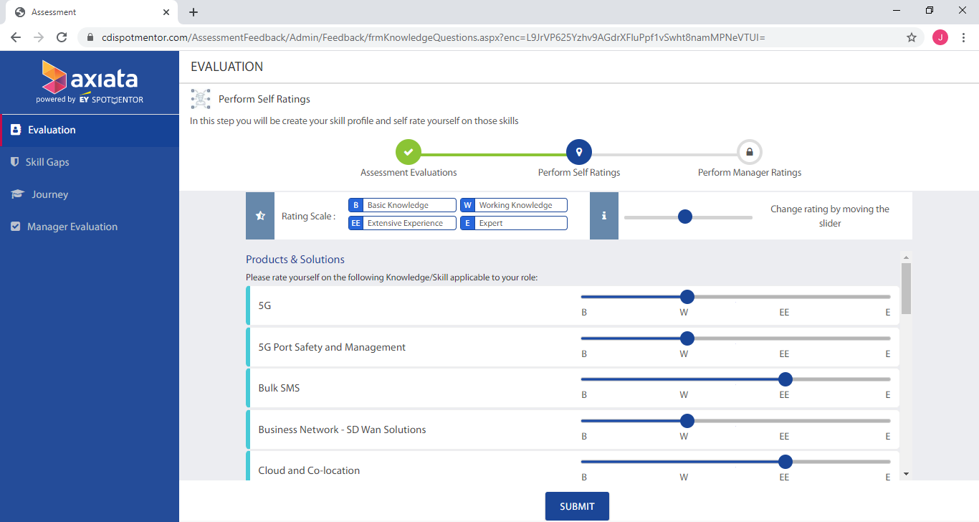
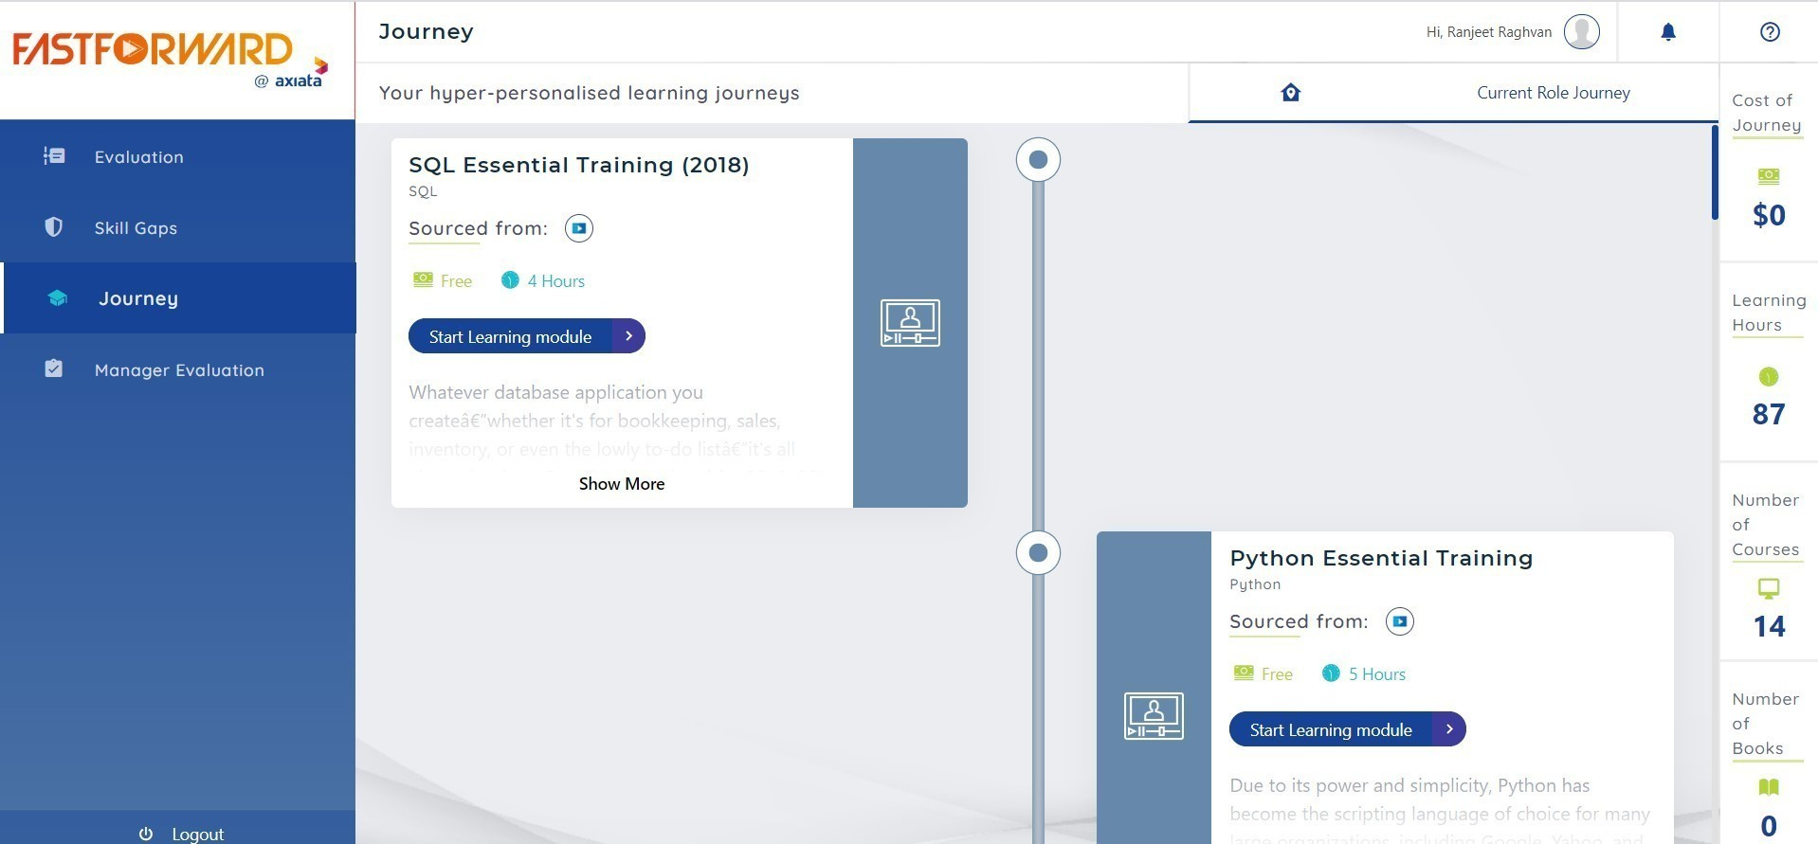
18. How to perform Self Ratings?
After closing the CDI window, you would be able to access the self ratings for knowledge competencies.
The knowledge competencies will be rated across 2 clusters – Products and Solutions, and Role Specific Skills. You will have to rate yourself on a scale of – Basic Knowledge (B), Working Knowledge (W), Extensive Experience (EE) and Expert (E).
To rate yourself, drag the blue button to the relevant scale
A
A
Note: Once you have submitted your self-ratings, your Manager will be automatically notified (via email) to perform Manager ratings

Slide 31
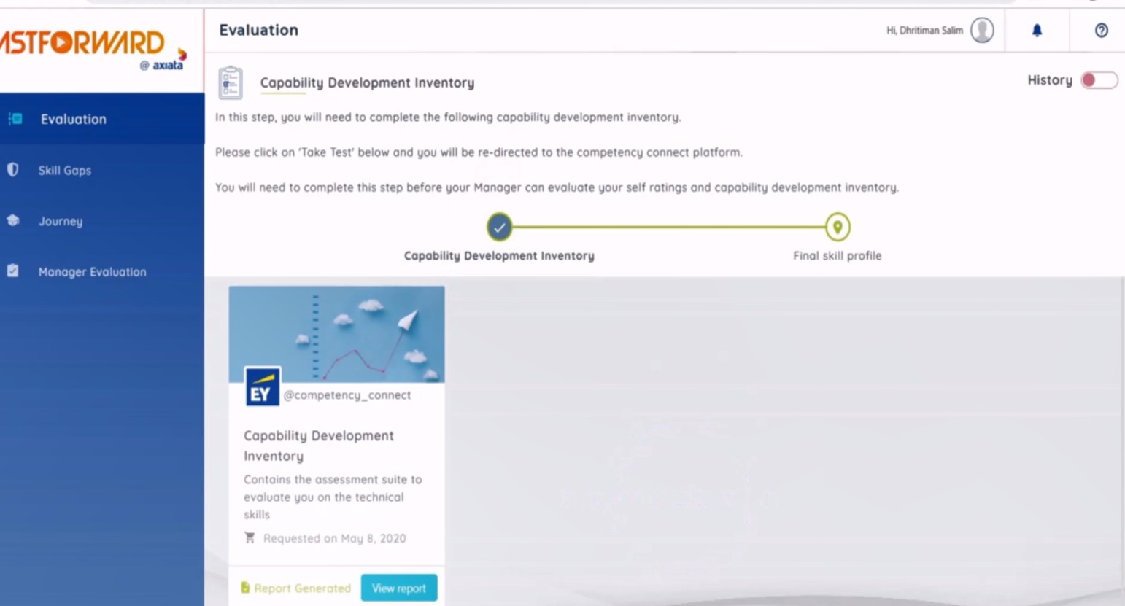
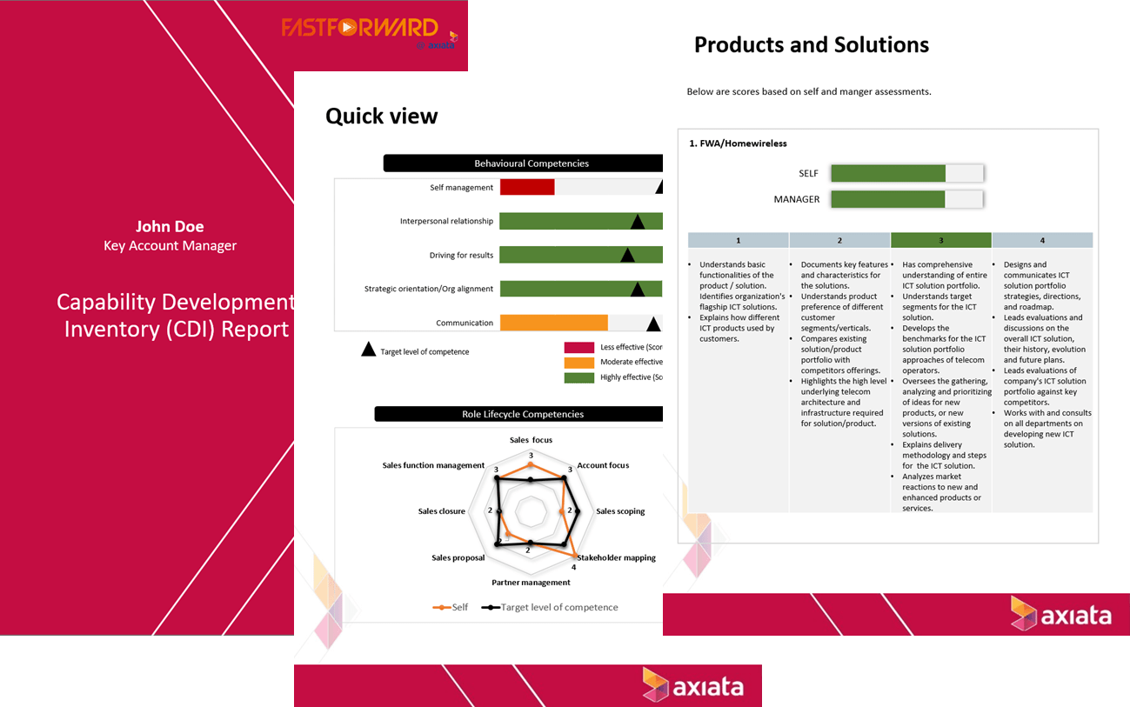
19. When to access the CDI report?
After completion of the entire process, you will receive an email indicating the availability of your detailed individual report. Click “Evaluation” > “View Report” to access your report accordingly
Note: This will only be available once your manager have completed their Manager’s rating
A
A
Sample of detailed individual CDI Report:

Slide 32
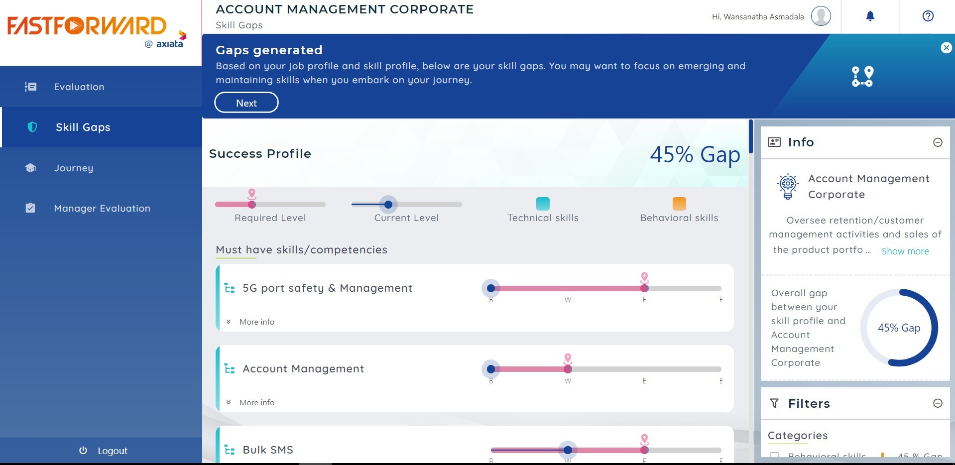
20. Where can I view my skill gaps
Click “Skill Gaps” to view your skill gaps for each competency – current level vs required level.
Your required (target) level and the current level will be highlighted based on your CDI results
A
B
A
B

Slide 33
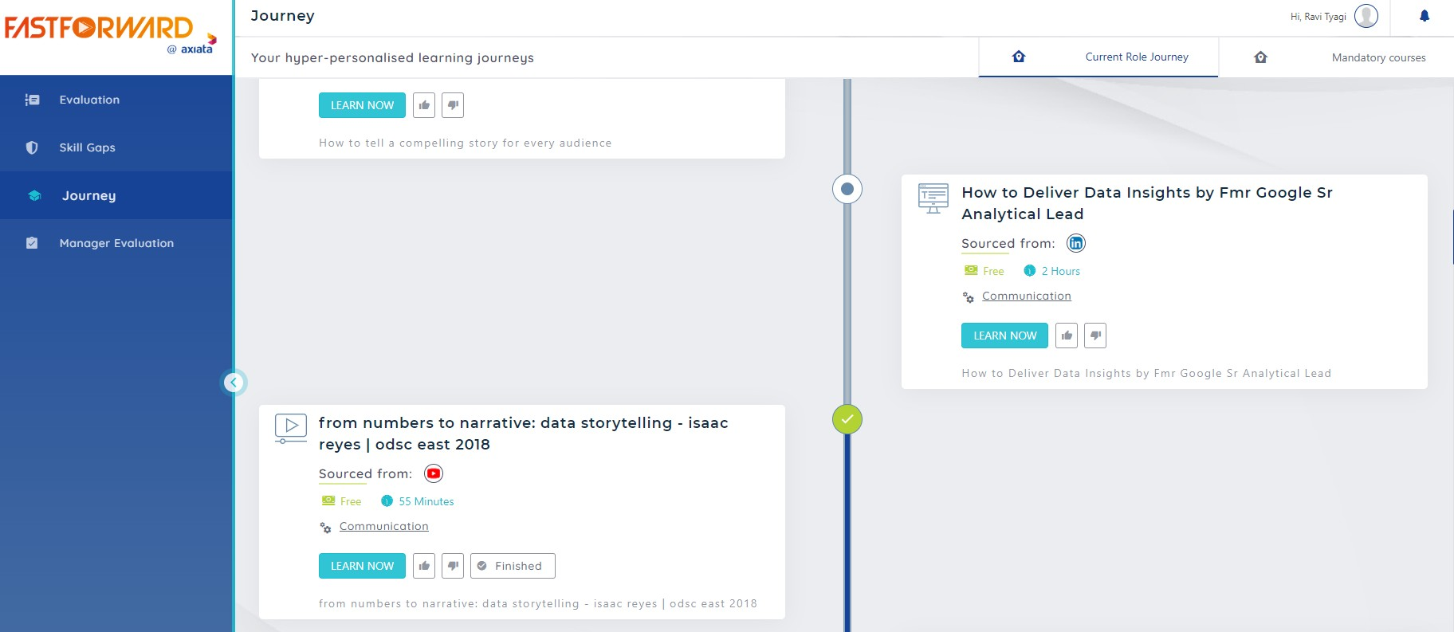
20. Where can I view and start my learning journey? (1/6)
Click “Journey” tab to view your personalised learning journey
Your journey tab is split into two tabs:
Mandatory Courses: Courses that are standardised across participants within the same role
Current Role Journey: Courses that have been curated based on your skill gaps
Note: You MUST complete all courses (learning modules) in BOTH tabs
Click “Learn More” to begin a course. You will be re-directed to the respective course provider’s platform
Your learning journey consists of curated content modules from LinkedIn, Coursera or other content sources.
A
B
A
B
C
B
A
The Art of Negotiation
C
Sales Prospecting

Slide 34
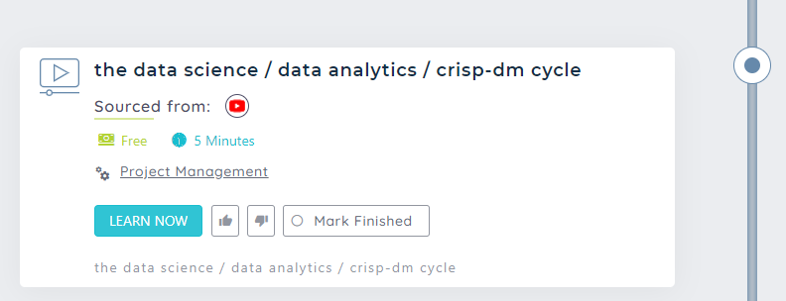
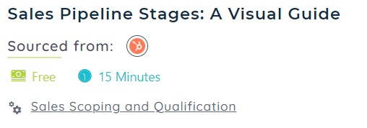
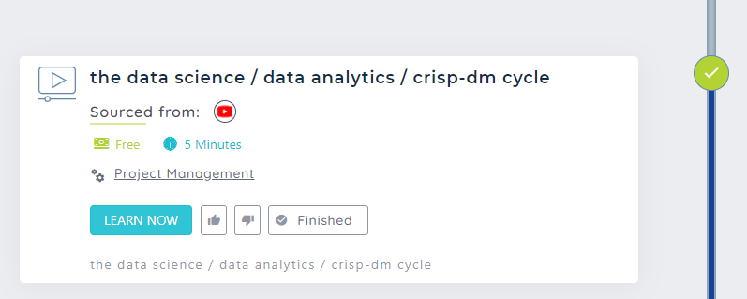
20. Where can I view and start my learning journey? (2/6)
For modules that are NOT LinkedIn modules:
Upon clicking the “Learn Now” button, the “Mark Finished” button will be enabled. You MUST click on that “Mark Finished” button for it to be marked as “Finished”
Once the “Finished” button appears, you will notice that a white tick in a green circle will appear on the journey – and the bar will change to dark blue in colour
A
B
A
B
A
B
B

Slide 35
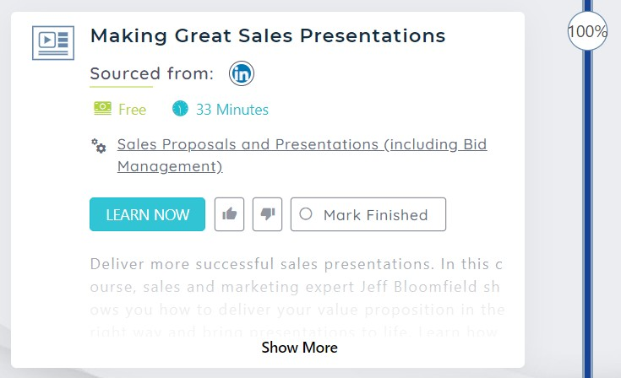
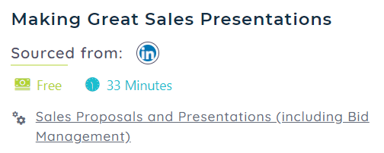
20. Where can I view and start my learning journey? (3/6)
For LinkedIn modules:
As the synchronization between LinkedIn and Spotmentor happens only once a day, the “Mark Finished” button will be enabled on the following day of the module completion.
Click on the “Mark Finished” button to indicate that you have completed the module. The button will then become “Finished”
Once the “Finished” button appears, you will notice that a white tick in a green circle will appear on the journey – and the bar will change to dark blue in colour
C
D
You have to complete 100% of the course
C
D
D

Slide 36
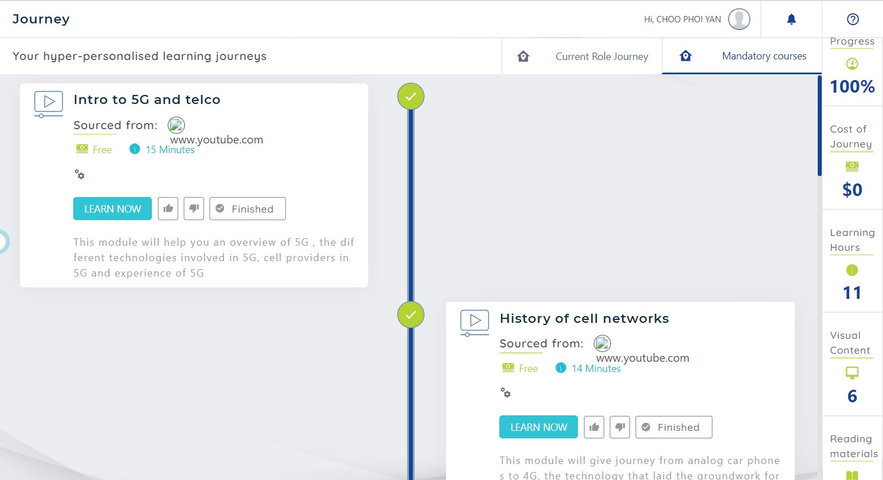
20. Where can I view and start my learning journey? (4/6)
Your learning journey progress will be reflected on the panel on the right – the percentage completion will increase, while your learning hours will reduce accordingly
E
E

Slide 37
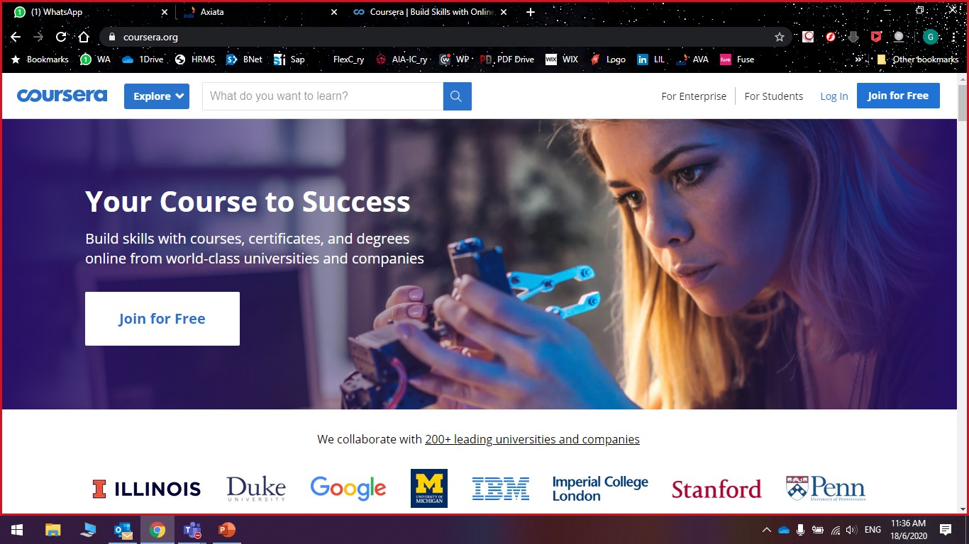
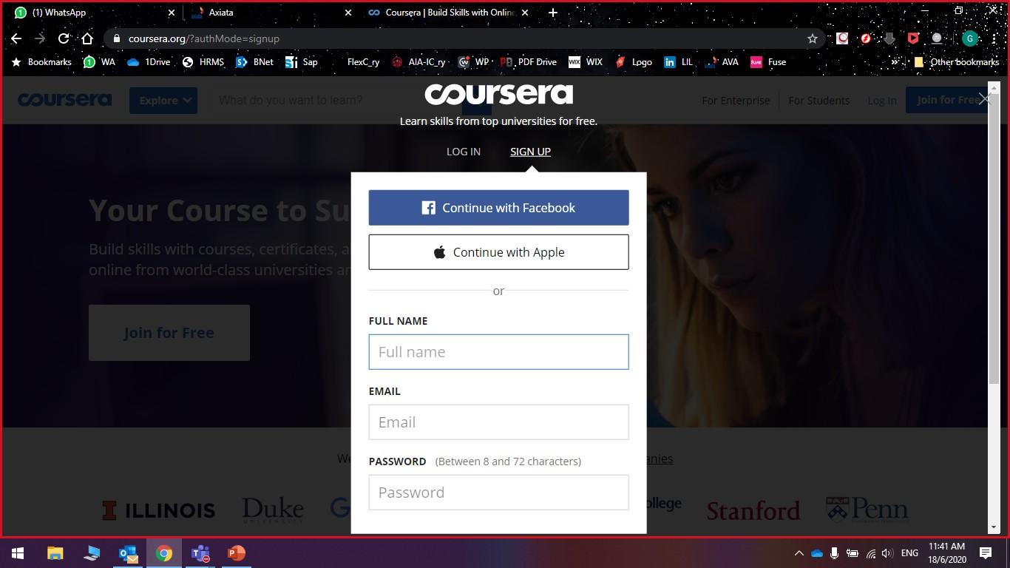
20. Where can I view and start my learning journey? (5/6)
If you do not have a Coursera or LinkedIn corporate account, please conduct the following:
LinkedIn – Contact your OpCo L&D for an invitation
Coursera
Click “Join for Free”
Register using Facebook credentials; Apple credentials OR entering personal details to continue
You may then proceed to access desired course
A
B
A
B

Slide 38
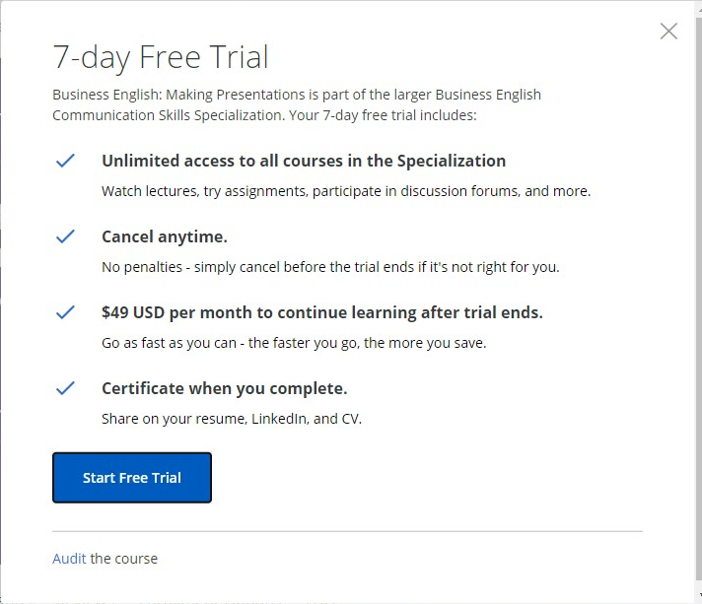
20. Where can I view and start my learning journey? (6/6)
When you are prompted with a “Paid” course, please select “Audit the course” option (refer visual)
You may then view all forums, reading materials, videos & quizzes (but cannot submit quizzes)
Upon completion of going through all materials (in Audit option). Learners must notify the administrators (aida.ishak@celcom.com.my, azlan@axiata.com) that they have completed consuming all learning materials under the Audit option by providing a progress screen shot from their personal Coursera accounts in order to qualify for a license.
C
C
Disclaimer: Licenses assigned are not perpetual. Should the need arises, the Company will revoke the license/access at discretion, where the ones likely to lose their license would be the dormant or least active accounts or accounts where learning progress in a course has been stagnant for an extensive period of time. This will be done without notice to the license holder

Slide 39
User Guide Overview
Key information on CDI and IT checklist
Step-by-Step Guide
through the platforms (Participant)
Step-by-Step Guide
through the platforms (Manager)
Frequently Asked Questions (FAQs)
Key Contact Persons

Slide 40
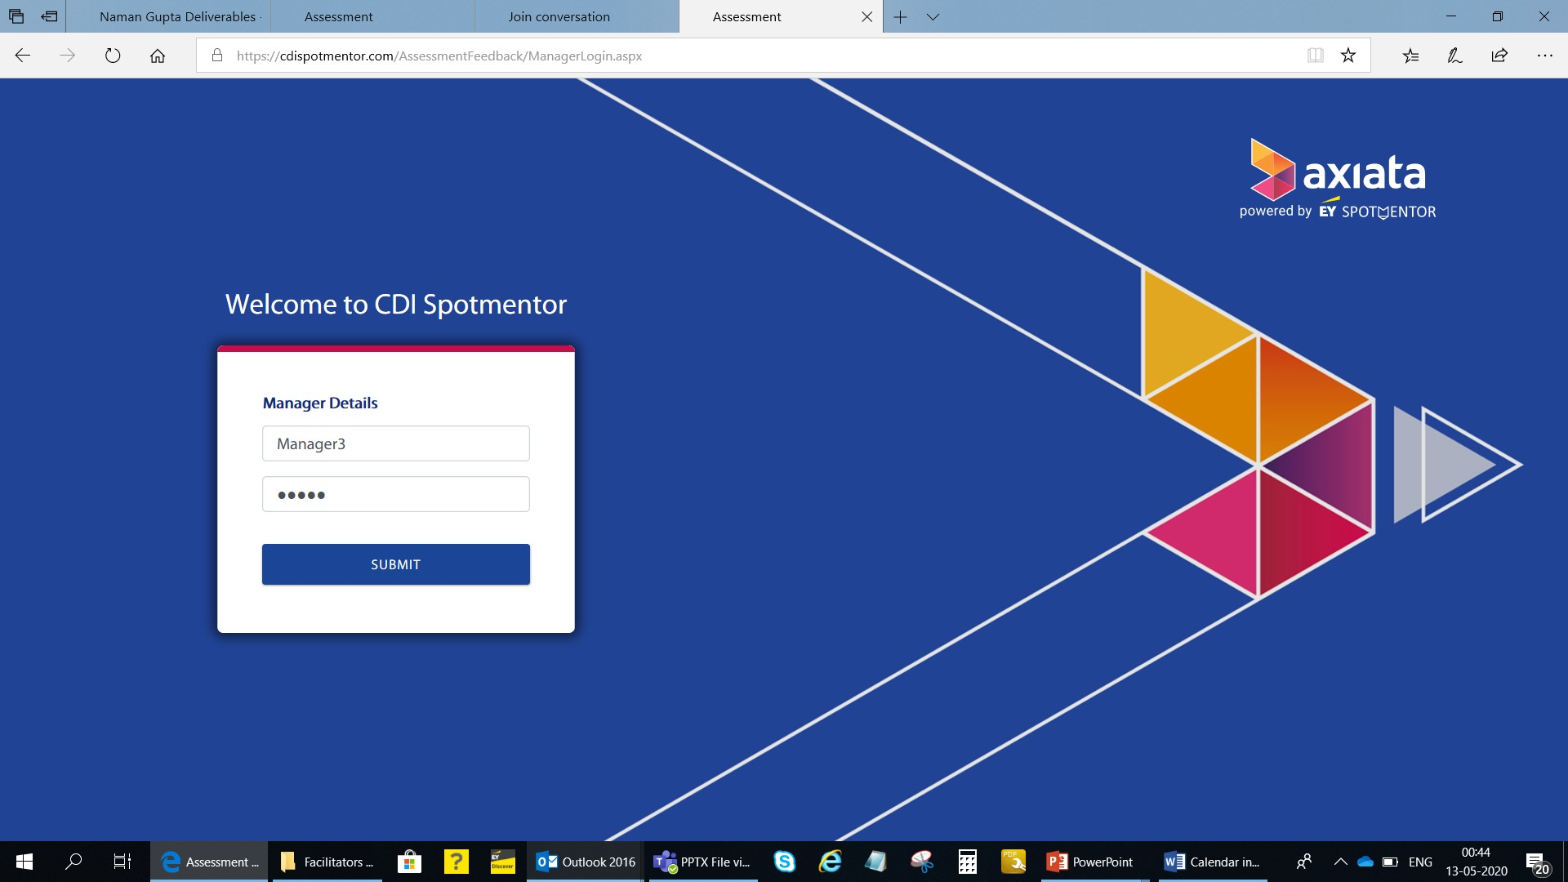
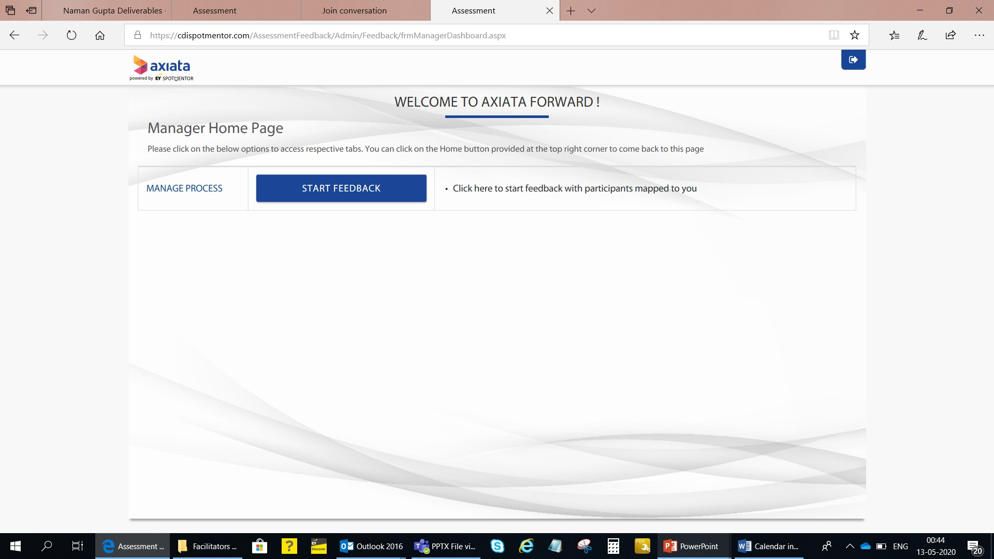
1. How do I access EY platform for submitting feedback ratings for a team member?
You will receive a mail from axiatafastforward.cdi@axiatafastforward.com which will contain a link to access the EY platform along with credentials. Access the link and input the credentials.
Click on Start Feedback to rate participants mapped to you
A
B
A
B

Slide 41
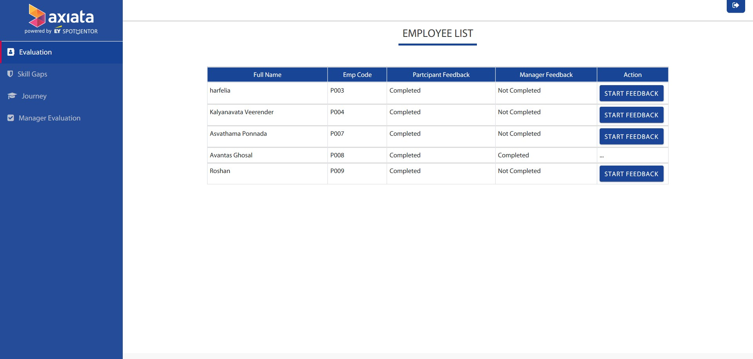
2. Where do I see the full list of participants mapped to me?
You will now see the full list of participants for whom you have to submit feedback ratings. Ratings have to be submitted within 3 days of receiving the mail from EY
Click on Start Feedback to start rating every participant
For every participant, ratings have to be provided across Products & Solutions, and Role-specific skills on a scale ranging from – Basic Knowledge (B), Working Knowledge (W), Extensive Experience (EE), Expert (E)
C
D
C
D

Slide 42
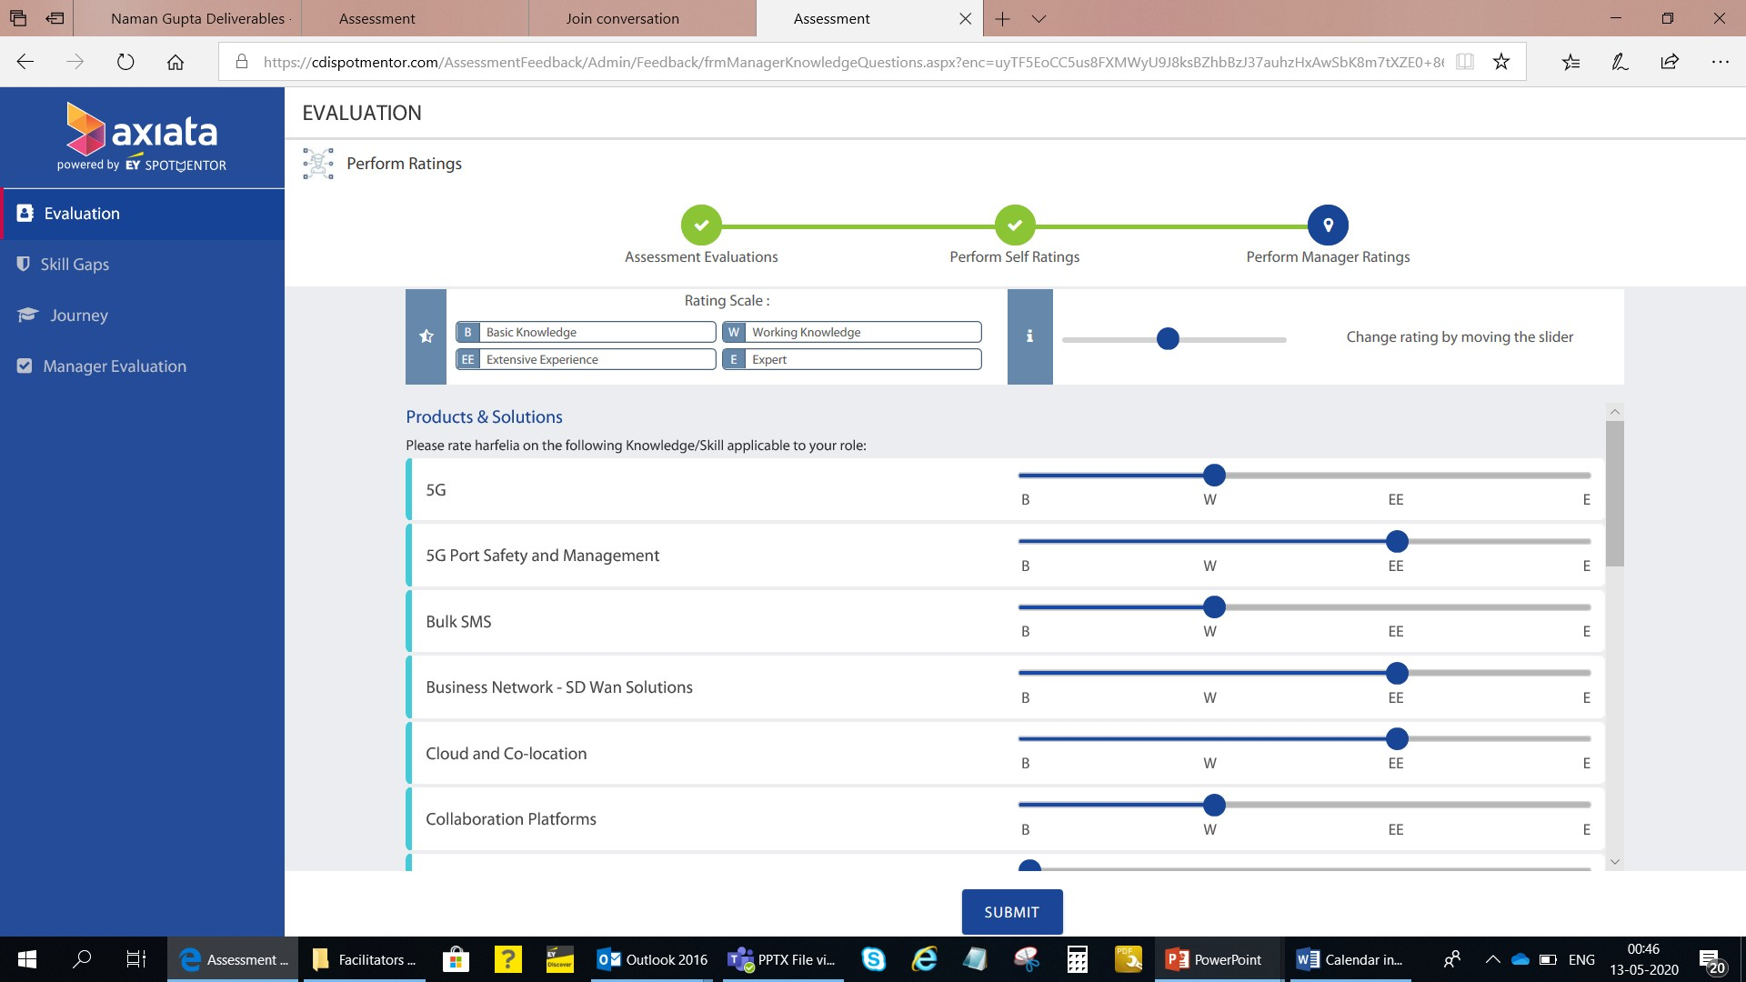
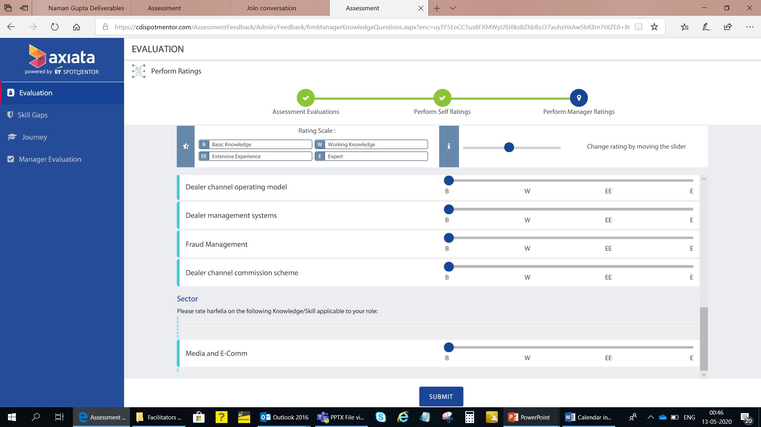
3. How do I submit the ratings?
You can rate the participant by moving the blue button to the desired scale for every knowledge competency
After rating the participant across all Products & Solutions, and Role-specific skills, click on Submit to save and record your responses
You can now continue to rate the other participants or log out.
E
F
E
F

Slide 43
User Guide Overview
Key information on CDI and IT checklist
Step-by-Step Guide
through the platforms (Participant)
Step-by-Step Guide
through the platforms (Manager)
Frequently Asked Questions (FAQs)
Key Contact Persons

Slide 44
Frequently Asked Questions (FAQ) (1/4)
No. | Question | Response
General
1. | I did not receive my username and password for FUSE/ EY Spotmentor. Who should I contact? | Please first check your spam/ Junk folder for emails from fastforward@axiata.com (FUSE) and admin@spotmentor.com (Spotmentor). If the credential email is not in the folder, please contact: Fuse Email directly to (either one): Gideon Tan (gideon.tan.hoe@celcom.com.my), Nurusyifa Binti Abdul Hamid (nurusyifa@celcom.com.my, Ena Erawati Salleh (ena_erawati@celcom.com.my) EY Spotmentor Email directly to: techsupport@axiatafastforward.com
2. | The email from admin@spotmentor.com is in the quarantine folder and I cannot release it, what should I do? | Please contact your IT Helpdesk at the earliest
3. | Why am I not able to login after I have copied and pasted my username and password credentials? | Please type your password (do not copy & paste) and ensure that there is no spacing when entering your password
4. | I am facing technical issues when using FUSE/ EY Spotmentor/ EY CompetencyConnect. Who should I contact? | Fuse Email directly to (either one): Gideon Tan (gideon.tan.hoe@celcom.com.my), Nurusyifa Binti Abdul Hamid (nurusyifa@celcom.com.my, Ena Erawati Salleh (ena_erawati@celcom.com.my) EY Spotmentor & CompetencyConnect Email directly to: techsupport@axiatafastforward.com
5. | Is the Enterprise Academy only for Account Managers? | At present, the Enterprise Academy comprises of the following roles: Account Management – Public Sector Account Management – Corporate Sector SME – Direct Channel SME – Indirect Channel Solutions Architect

Slide 45
Frequently Asked Questions (FAQ) (2/4)
No. | Question | Response
CDI
6. | Is the CDI session compulsory? | Yes, it is compulsory
7. | Can I request for a different timeslot to complete my CDI? | Rescheduling of your CDI is not permitted under any circumstances.
8. | What are the IT requirements for the CDI? | Refer to IT Checklist in this User Guide
9. | What happens if I do not complete the tasks within the stipulated timeframe? | This is a timed assessment. If you do not complete the task within the specified time, the platform is configured to automatically start the next task. Please manage your time accordingly.
10. | What if I get logged out of my CDI? | You can re-login into FUSE -> EY Spotmentor -> CDI and continue where you last left off
11. | Should I dress up formally? | Yes, you need to dress up smartly for the CDI
12. | Can I use only audio for my discussion with the facilitator? | No, a video call is mandatory for discussion with the facilitator.
13. | How will I know the result of my CDI? | Once manager rating is completed, a detailed report will be shared with every participant containing both the qualitative and quantitative findings as adjudged by the facilitator during the CDI.

Slide 46
Frequently Asked Questions (FAQ) (3/4)
No. | Question | Response
CDI (Cont’d)
14. | Can I change my responses/ answers to previous questions? | You can change the response/ answer to previous questions so long as you have not clicked “Submit” for a task. Thereafter, you will no longer be able to change your responses/ answers
15. | What am I being rated on during the CDI? | You will be rated on behavioral and role life cycle competencies relevant for your level and role cluster.
16. | What is the basis of the self and manager ratings? | The self and manager ratings is to evaluate you on knowledge competencies.
17. | Do I need to personally inform my Manager to perform the Manager ratings? | No. After you click “Submit” upon completion of self rating, an automatic email trigger will be sent to your Manager

Slide 47
Frequently Asked Questions (FAQ) (4/4)
No. | Question | Response
Learning Journey
18. | There are too many learning modules for me to complete. Do I need to complete all of them? | Yes, you will need to complete all of them. It is expected for each participant to spend about up to 4 hours a week on these modules.
19. | I think the learning modules are too easy/ challenging for me and/ or not relevant to my role. What should I do? | Please raise this with your OpCo HR and L&D. You can also include this in the Program Feedback Form circulated on a bi-weekly basis.
20. | I have made some progress or have completed a LinkedIn module. Why is the % progress on my learning journey in Spotmentor not updated? The ‘Mark Finished’ button is also not visible/ enabled for me. Why is that so? | Progress updates between LinkedIn and Spotmentor is only synchronized once a day. Your % progress will also be synchronized once a day, which can be seen on the learning journey itself. If you have fully completed a module, the ‘Mark Finished’ button will be enabled on the following day. You will need to click on that button for it to change to a ‘Finished’ status.
21. | Can I change the modules that are on my Learning Journey? | No, you are not able to change the modules as they have been curated based on your skill gaps profile.
22. | I have completed my self-rating and CDI. Why am I not able to view my learning journey? | Your learning journey will only be available after you have completed your self-rating, CDI and have received your Manager’s rating.
23. | How do I know if my progress on the learning journey is being tracked? | You will need to click on the ‘Mark Finished’ button after you have completed that selected module. You will notice that it will become a ‘Finished’ status upon clicking. Do note that the ‘Mark Finished’ button will only be enabled after you have clicked completed that module. Your progress will be tracked based on the ‘Mark Finished’ button.

Slide 48
User Guide Overview
Key information on CDI and IT checklist
Step-by-Step Guide
through the platforms (Participant)
Step-by-Step Guide
through the platforms (Manager)
Frequently Asked Questions (FAQs)
Key Contact Persons

Slide 49
Key Contact Persons
Please reach out to the following PICs for any queries/ concerns:
System-related
All other matters – please reach out to your respective OpCO HR & L&D
System | Contact Person
Fuse | Nurusyifa Binti Abdul Hamid – nurusyifa@celcom.com.my Ena Erawati Salleh – ena_erawati@celcom.com.my Gideon Tan – gideon.tan.hoe@celcom.com.my
Spotmentor/ CompetencyConnect | Email: techsupport@axiatafastforward.com
OpCo | Contact Person
Celcom | Wendy Ak Pero – wendy_ap@celcom.com.my Samuel Saravanan – sameul.saravanan@celcom.com.my
Dialog | Rekha Weerasooriya – Rekha.Weerasooriya@dialog.lk Johaan Isaac – Johaan.Isaac@dialog.lk Sanaree Godagama – Sanaree.Godagama@dialog.lk
XL | Rama Yanti – RYANTI@xl.co.id Andree Murtantyo – ANDREEM@xl.co.id
Robi | Shirin Khan – shirin.khan@robi.com.bd Munim Ahmed – munim.ahmed@robi.com.bd
NCell | Eliza Pradhan – eliza.pradhan@ncell.axiata.com

Slide 50
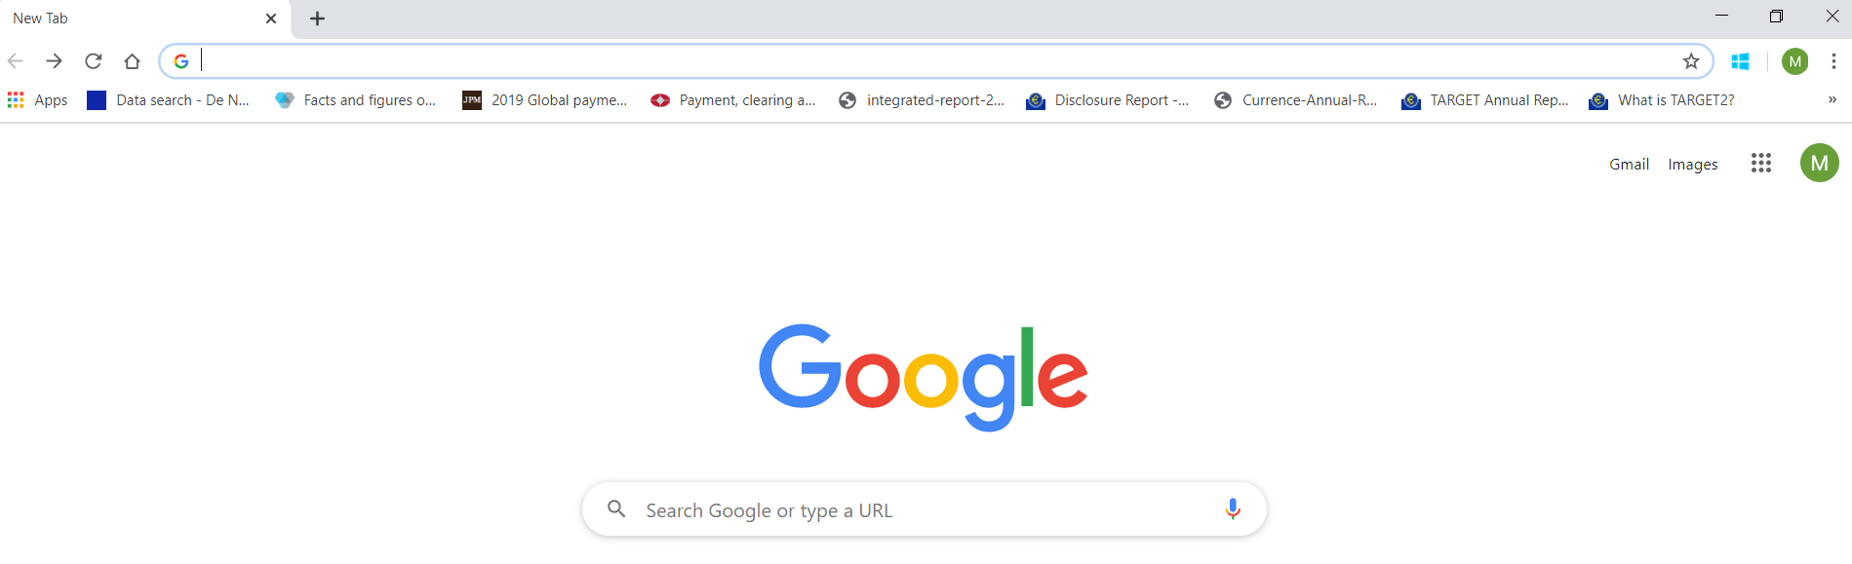


Annexures – Enabling Pop Ups (1/2)
To enable pop ups on Chrome, go to Settings -> Click Settings
Click Site Settings
A
B
A
Click here
A
B

Slide 51

Annexures – Enabling Pop Ups (1/2)
Slide the blocked slider to the right (i.e. turn on)
C
C

Slide 52


Annexures – Check Go-to-Meeting Link (1/2)
Go to https://support.goto.com/meeting/help/join-a-test-session-g2m050001
Please use Google Chrome browser
Click “Join Now”
Click “Open GoTo Opener” – the GoTo Opener will appear in a separate tab
A
B
A
B

Slide 53


Annexures – Check Go-to-Meeting Link (2/2)
Click “OK, I’M READY”
Ensure your Mic and Camera are enabled on the day of your CDI
A
B
A
B

Slide 54
Let’s FastForward to a
sustainable future, together!

Slide 55


Annexures – Downloading AnyDesk (1/2)
Go to anydesk.com/en
Click on Free Download
Close the pop-up window
A
B
A
B

Slide 56

Annexures – Downloading AnyDesk (2/2)
Click on the downloaded .exe file that appears on the lower left corner
Make note of your 9 digit unique number. This is your unique laptop number and will need to be given to the IT tech support team for remote tech support
C
D
C
D

Slide 57

17. How to perform Self Ratings? (2/2)
To rate yourself on Sectors, first, select the relevant Sectors from the drop down. You can select a minimum of one and a maximum of three sectors.
Rate yourself across the relevant Sectors by dragging the blue button
Once you have completed the self rating, click Submit to trigger Manager ratings. An email prompt will be sent to your Manager, requesting him/ her to provide his/ her ratings for you.
You can then log out and exit the system
Axiata FastForward team would reach out to you on the next steps
C
D
E
F
G
C
D
E

